Slide 2
ERKAT DRUM CUTTERS
Short Basic Product Training
for Al Shirawi Enterprises, UAE
By Chris Goebel
06.04.2020

Slide 3
AGENDA FOR SHORT BASIC PRODUCT TRAINING
Who are we
General principle of rock cutting
Product portofolio of drum cutters
Product range and key specs
Cutting tools
Typical application examples
Separate presentation about trenching applications in ME region
How to choose the correct cutter model
Non-standard versions and options
Technical details
Installation & Commissioning
Competition
Answering Questions

Slide 4
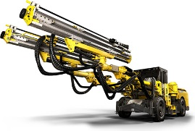
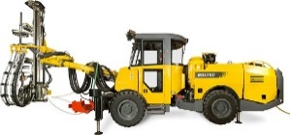
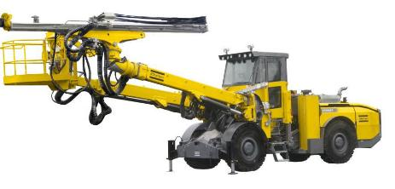
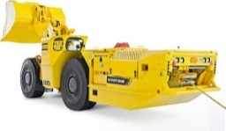
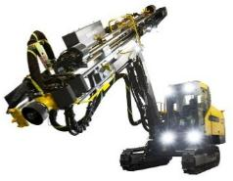
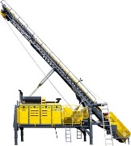
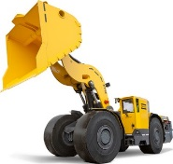
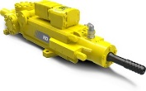
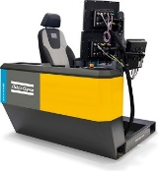
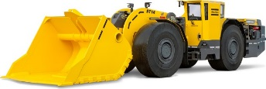
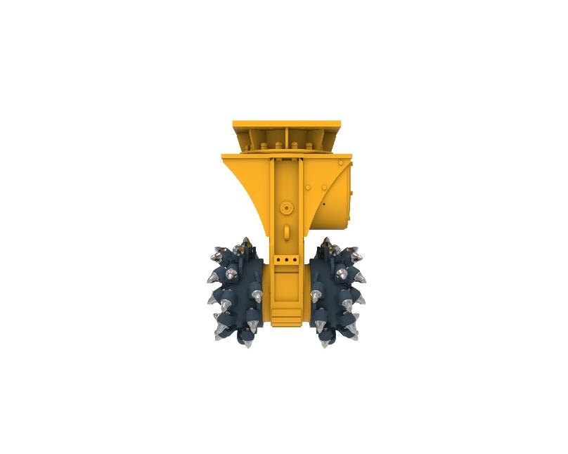
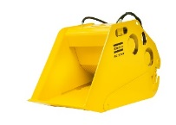
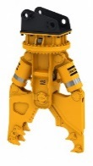
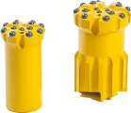
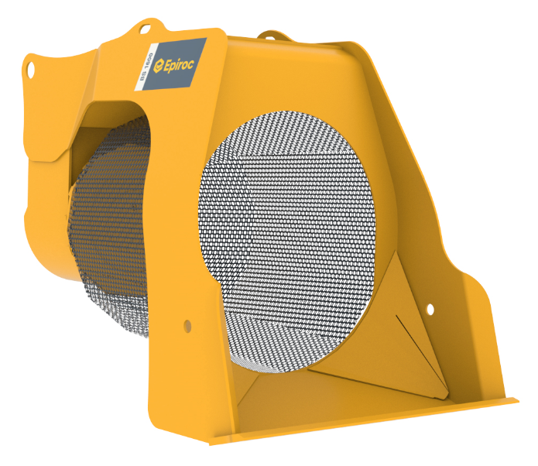
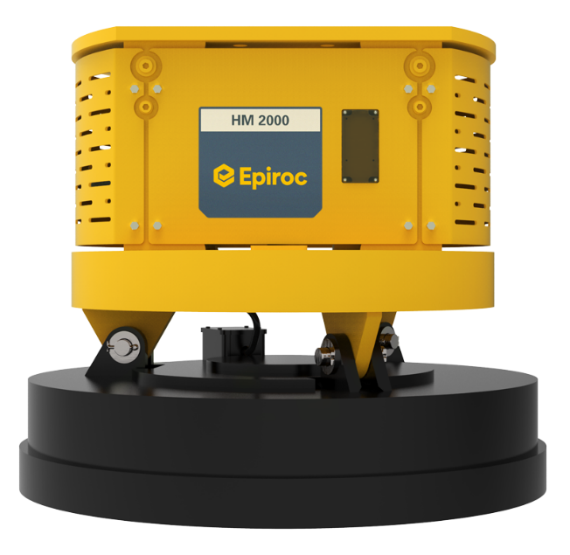
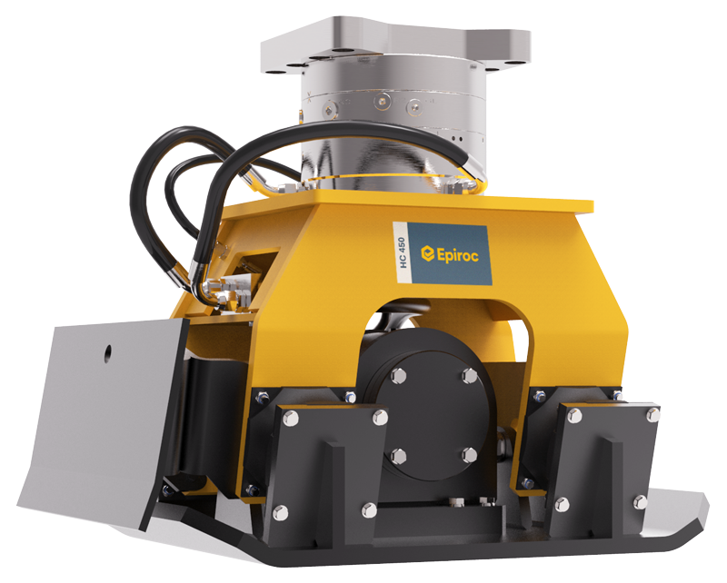
Epiroc Product Range

Slide 5
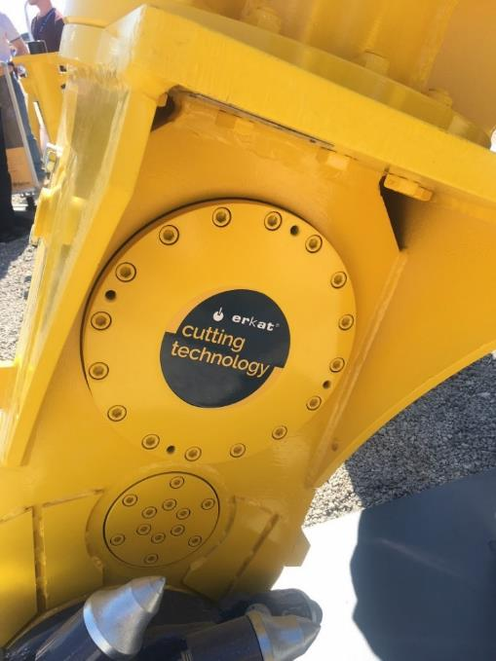
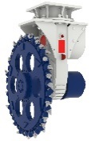
ACQUISTION FACTS
ERKAT Spezialmaschinen & Service GmbH established in 2000
ERKAT Spezialmaschinen & Service GmbH acquired by Atlas Copco Construction Tools in 2017 and part of the EPIROC Group
Ownership of ERKET GmbH & Co. KG remained unchanged; not part of the EPIROC Group (now acting under Kemroc branding)

Slide 6
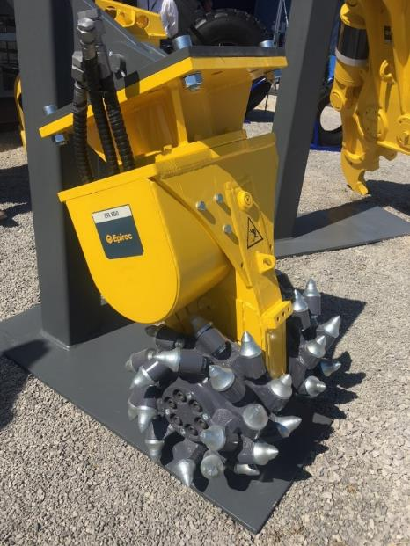
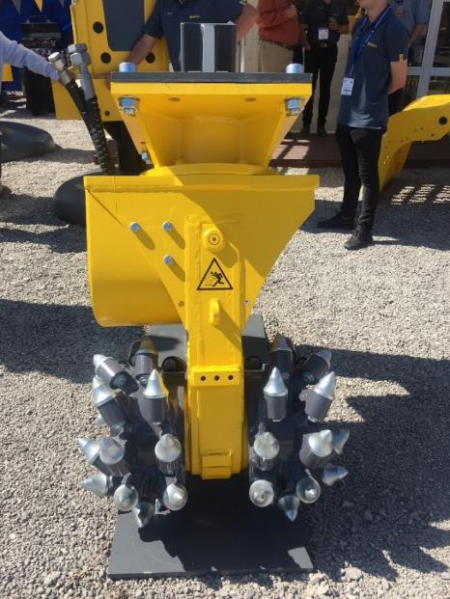
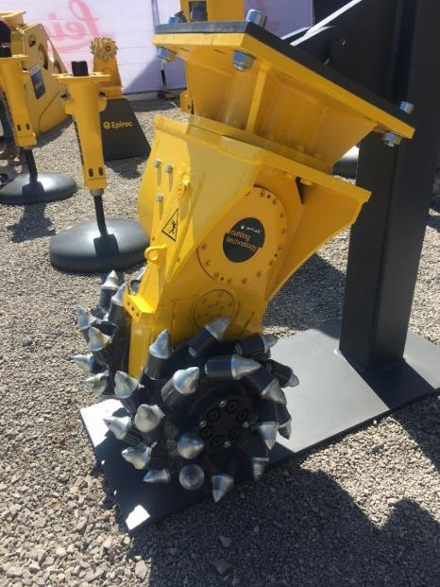
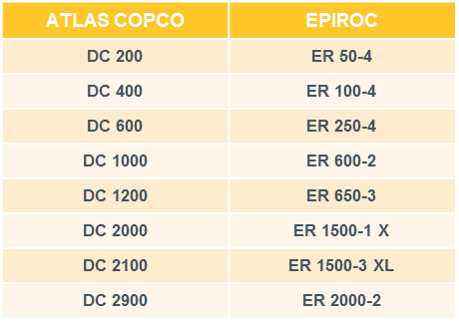
EPIROC REBRANDING
Atlas Copco had only specify models (one motor size), i.e. not the full Erkat range
SAME MODEL DESIGNATION AS ERKAT

Slide 7
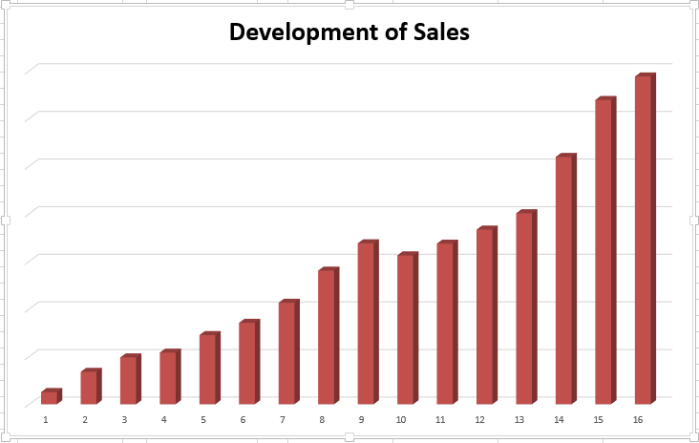
DRUM CUTTER SALES DEVELOPMENT

Slide 8
Drum cutters
Brand world map 2019

Slide 9
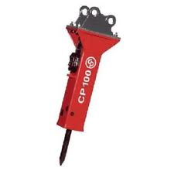
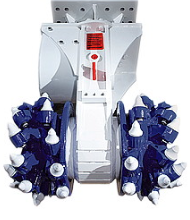
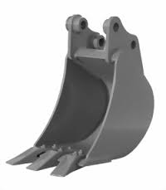
AREA OF APPLICATION FOR ROCK CUTTING
0 | 20 | 40 | 60 | 80 | 100 | 120 | 140 | 160 | 180 | 200 | 220 | 240
Compressive Rock Strength (MPa)

Slide 10
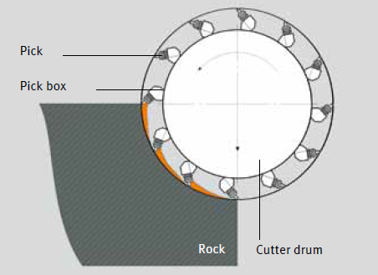
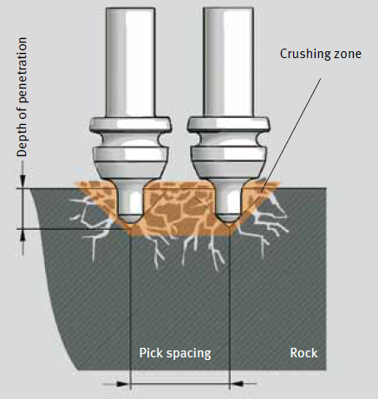
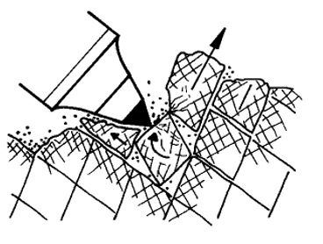
PRINCIPLE OF ROCK CUTTING

Slide 11
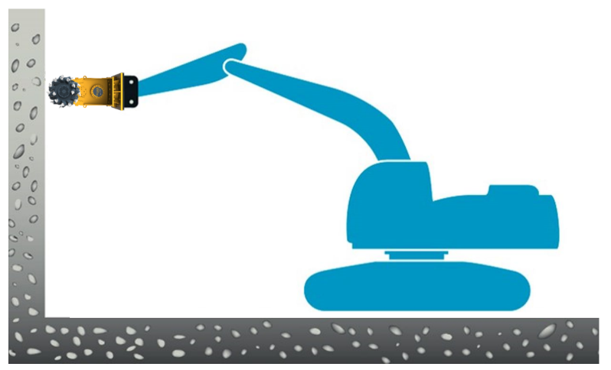
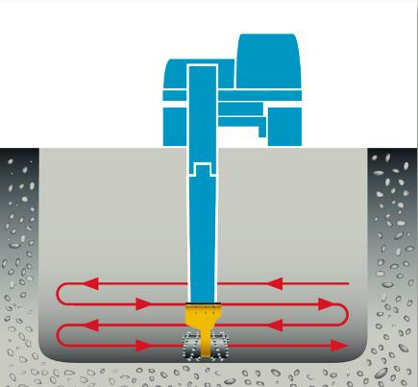
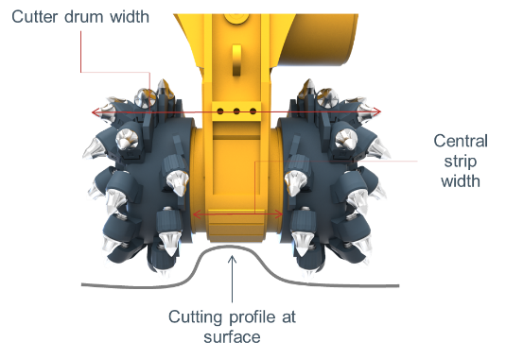
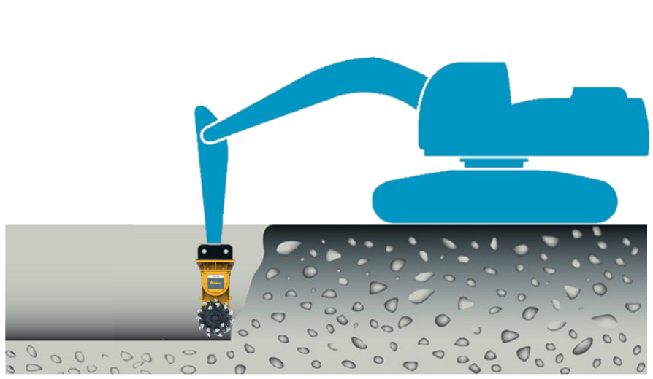
TRANSVERSE DRUM CUTTERS
Optimum cutting head working direction
Vertical surfaces
Horizontal surfaces
Transverse Drum Cutters have to be moved sideways to achieve the required depth and to protect the housing:
 Cutter drum width ≠ Min. Trench width
☑ Cutter drum width + Central strip width = Min. Trench width

Slide 12
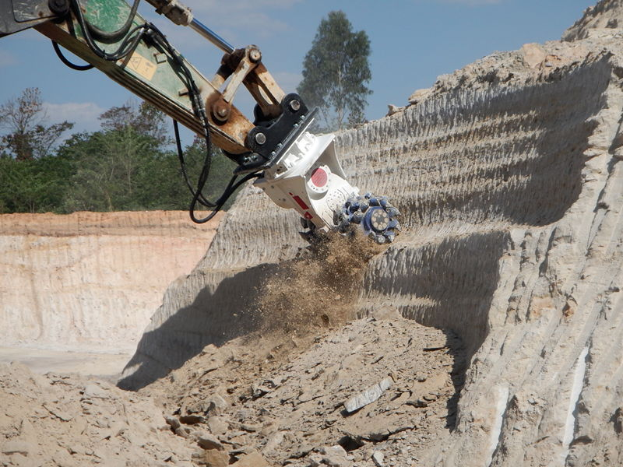
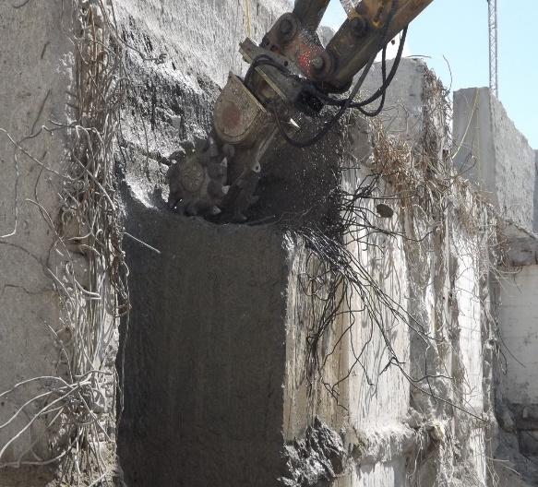
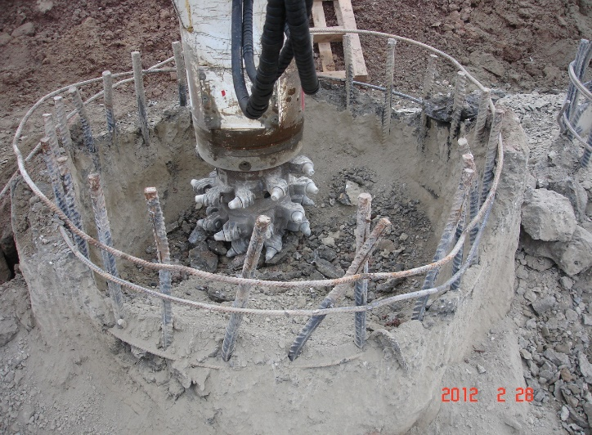
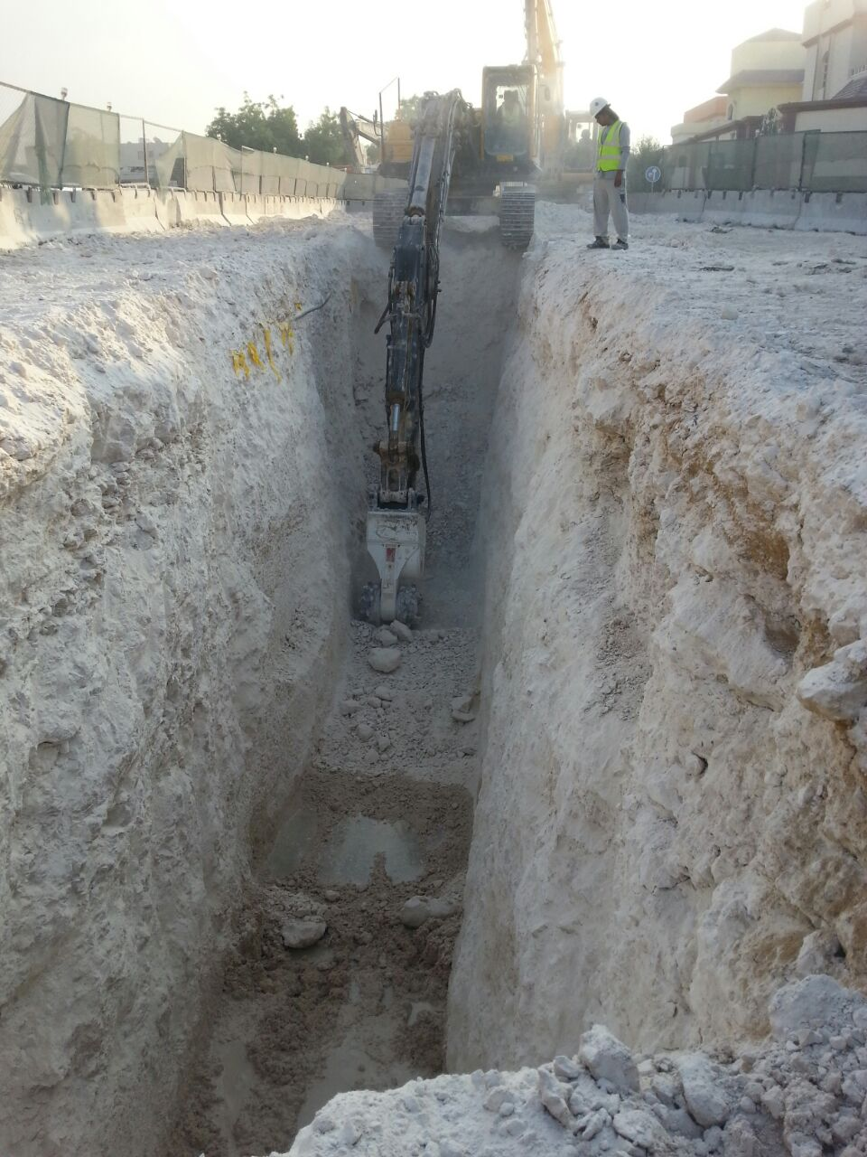
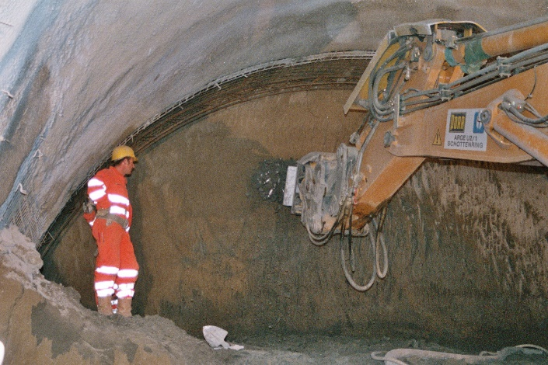
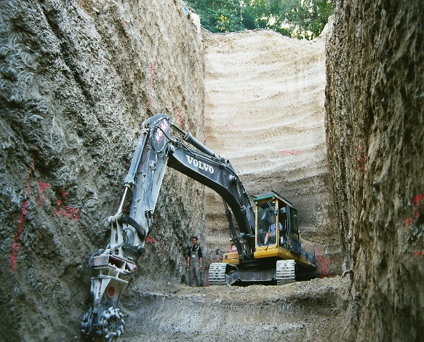
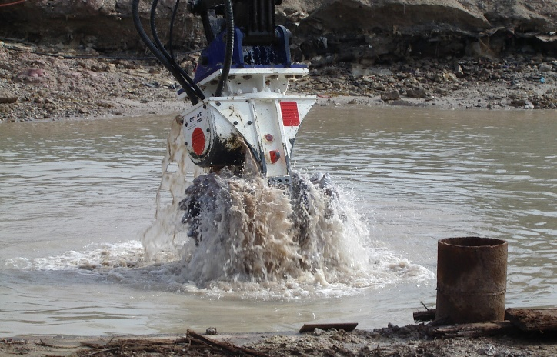
Main Drum Cutter Applications
Mining mass excavation
Demolition / rebuilding
Pilehead cutting
Trenching
Tunneling
Foundations
Underwater

Slide 13
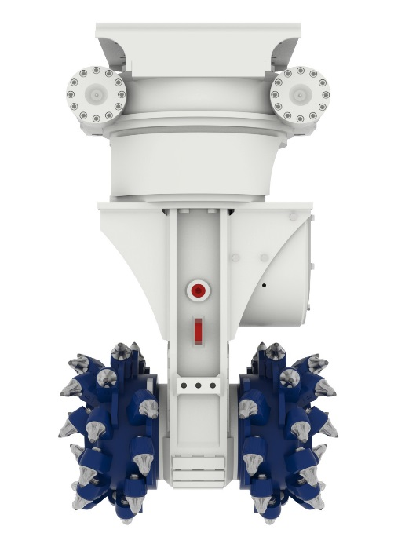
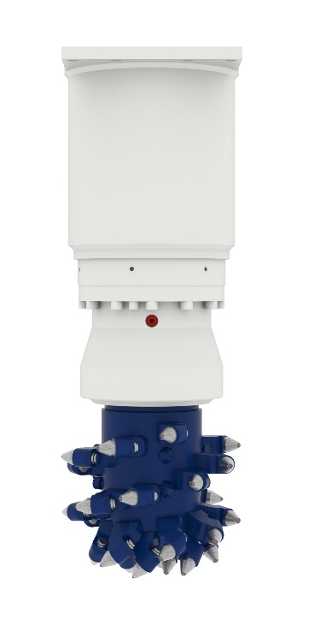
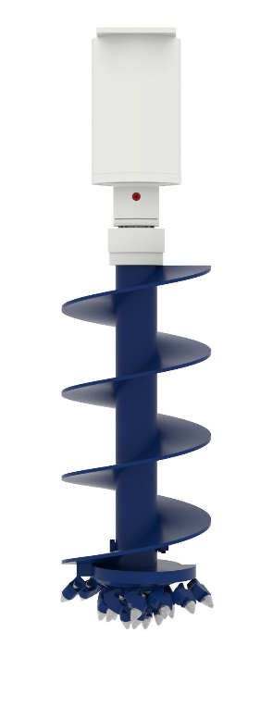
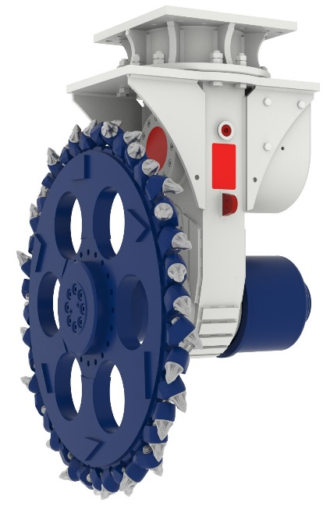
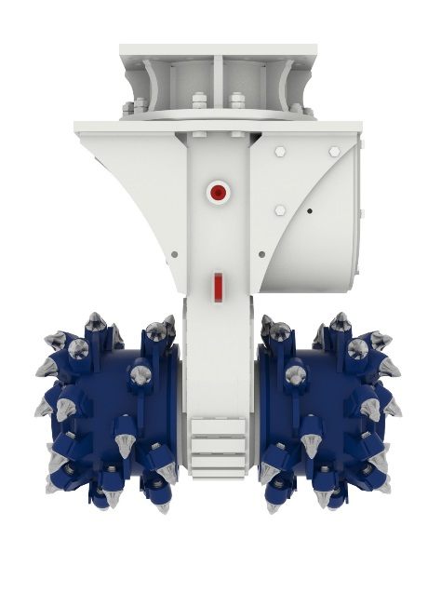
PRODUCT PORTFOLIO
TRANSVERSE DRUM CUTTERS
AXIAL DRUM CUTTERS
AUGERS
ER Range
without mechanic rotation
ERC Range
with hydraulic rotation
ER with Cutting Wheel
With mechanic or hydraulic rotation
ERL Range
ADU Range

Slide 14
PRODUCT PORTFOLIO
ERC with integrated hydraulic rotation While the ER models have a mechanical 360° rotatable bracket with central fixing bolt for positioning of the drum cutter, the new ERC models feature integrated hydraulic rotation which allows even greater accuracy and productivity in challenging applications. Common to both ER and ERC drum cutters are an adaptable high torque gear motor, which gives high efficiency with long motor lifetime, and a high load resistant output shaft bearing system with lubrication-free slide ring seal system. Robust spur gears allow optimum energy transmission and reliability and the rugged housings are enhanced by HARDOX wear protection for operation in the toughest working environments. A wide range of cutting heads for various applications is available for ER and ERC models. The QuickSnap retaining system enables fast, simple pick changing, and pick sleeves are replaceable. ER-L axial drum cutters The new ER-L axial or longitudinal drum cutters are designed for narrow trenching, pile head removal and gutter cleaning. They are equipped with an adaptable high torque radial piston motor and a strong lubrication-free bearing system, all protected by a robust housing. As with the other drum cutter models, a large variety of cutting heads is available for various applications and on the ER-L models the cutter head can be replaced by an auger for soft rock drilling. ADU auger drive units Epiroc's compact new auger drive units are suitable for challenging soil and soft rock drilling applications. The attachments are equipped with a high torque radial piston motor and a strong lubrication-free bearing system. A variety of augers is available for different applications and quick auger exchange allows maximum on-site flexibility. Erkat technology inside The Epiroc range of hydraulic drum cutter attachment tools was originally designed by Erkat Spezialmaschinen & Service GmbH, which was acquired by Atlas Copco in 2017, and the attachments thus incorporate Erkat technology. They are now easily recognisable as Epiroc products due to the distinctive grey label on the equipment.

Slide 15
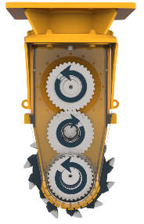
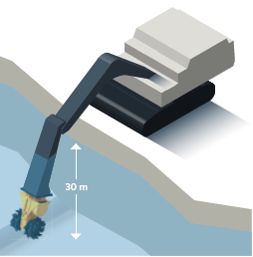
TRANSVERSE DRUM CUTTERS
Features ER Range
Mechnical 360° rotatable bracket (ER 50-3000) with central fixing bolt for easy positioning of drum cutter
Magnetic gear oil plug for easy oil condition check
Extremely robust spur gears for optimum energy transmission and reliability
High torque radial piston motor for higher productivity and motor lifetime
Displacement adaptable to match available excavator flow rate
1:1 Transmission
High load resistant output shaft bearing system with lubrication-free slide ring seal system
Pick sleeves (ER 1500-5500) are replaceable
QuickSnap retaining system (ER 600-3000) for quick and easy pick changing
Robust housing design with HARDOX wear protection for higher uptime
Can be used up to 30 meters underwater without additional installation or modification

Slide 16
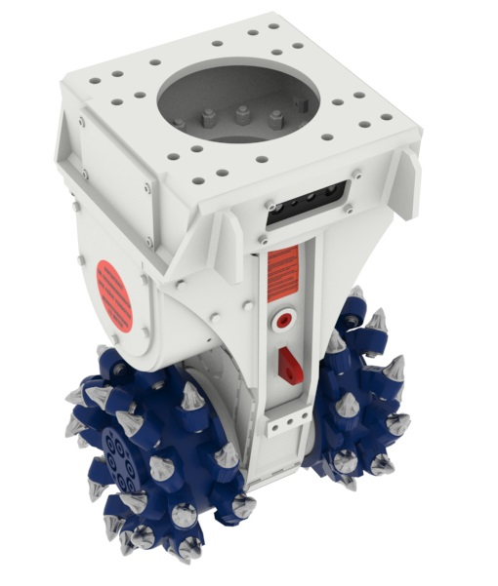
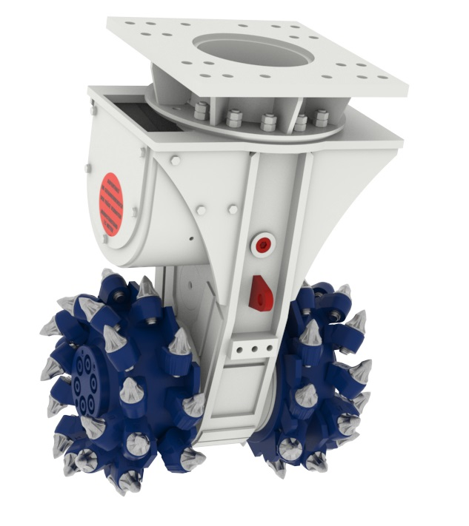
New Products & Developments
Transverse Drum Cutters with Choice of Consoles
Pro bracket version
Standard turntable version
Static bracket (ER 650-2000) with hoses at the rear side for better protection in trenching, demolition etc.
Mechanical 360° rotatable bracket (ER 50-3000) with central fixing bolt for easy positioning of drum cutter

Slide 17
Hydraulic Attachment Tools
Design overview
Design overview Transverse Drum Cutter
Central pin
Rotatable bracket
Motor shaft
Hydraulic motor
Spur gear
Slide ring sealing
Output shaft
Output flange
Cutting head

Slide 18
Hydraulic Attachment Tools
Function of a radial piston hydraulic motor
Rotation direction

Slide 19
TRANSVERSE DRUM CUTTERS
Technical key data ER Range
ER model | Drive power | Oil flow rate | Service weight | Excavator class | Recom. Rock hardness
ER 40 | 13 kW | 17 – 22 lpm | 110 kg | 0,6 – 2 to | < 20 MPa
ER 50 | 18 kW | 25 – 38 lpm | 200 kg | 1 – 3 to | < 25 Mpa
ER 100 | 30 kW | 52 – 62 lpm | 330 kg | 3 – 7 to | < 30 MPa
ER 250 | 45 kW | 60 – 85 lpm | 500 kg | 8 – 15 to | < 40 MPa
ER 600 | 65 kW | 120 – 150 lpm | 900 kg | 10 – 18 to | < 50 MPa
ER 650 | 80 kW | 140 – 190 lpm | 1.200 kg | 15 – 28 to | < 60 MPa
ER 1500 | 120 kW | 205 – 300 lpm | 2.100 kg | 20 – 40 to | < 80 MPa
ER 1700 | 120 kW | 290 – 360 lpm | 2.450 kg | 30 – 50 to | < 90 MPa
ER 2000 | 160 kW | 300 – 390 lpm | 2.900 kg | 30 – 55 to | < 100 MPa
ER 3000 | 200 kW | 350 – 450 lpm | 4.000 kg | 50 – 70 to | < 120 MPa
ER 5500 | 400 kW | 700- 950 lpm | 7.000 kg | 70 – 125 to | > 140 MPa

Slide 20
TRANSVERSE DRUM CUTTERS
Technical data ER Range (metric)
ER Range |  | ER 40X | ER 50X | ER 50 | ER 100X | ER 100 | ER 250X | ER 250 | ER 600
Carrier weight class ¹ | t | 0.6 - 2 | 1 - 3 | 1 - 3 | 3 - 8 | 3 - 8 | 8 - 15 | 8 - 15 | 10 - 18
Service weight ² | kg | 110 | 170 | 200 | 330 | 350 | 520 | 570 | 900
Product weight | kg | 90 | 130 | 160 | 290 | 310 | 450 | 500 | 820
Nominal power | kW | 13 | 18 | 18 | 30 | 30 | 45 | 45 | 65
A | mm | 495 | 610 | 615 | 805 | 805 | 940 | 965 | 1.130
B | mm | 400 | 400 | 500 | 500 | 610 | 600 | 685 | 795
C | mm | 225 | 225 | 240 | 370 | 370 | 400 | 450 | 575
Rotational speed | rpm | 130 | 150 | 150 | 115 | 115 | 90 | 90 | 80
Optimum oil flow ³ | l/min | 17 - 22 | 25 -38 | 25 - 38 | 52 - 62 | 41 - 62 | 60 - 85 | 60 - 85 | 120 - 150
Maximum torque ⁴ | Nm | 960 | 1.420 | 1.420 | 3.000 | 3.000 | 5.200 | 5.200 | 10.100
Maximum cutting force ⁴ | N | 8.530 | 12.620 | 11.850 | 16.200 | 16.200 | 26.000 | 23.200 | 35.100
Pick shaft diameter | mm | 11.4 | 11.4 | 15 | 20 | 20 | 20 | 22 | 25
Number of picks | pcs | 40 | 40 | 56 | 44 | 64 | 44 | 44 | 48
Maximum oil flow ⁵ | l/min | 40 | 60 | 60 | 90 | 90 | 100 | 100 | 170
Maximum operating pressure | bar | 350 | 350 | 350 | 350 | 350 | 350 | 350 | 350
¹ Weights apply to standard carriers only. Any variances must be agreed with Epiroc and/or the carrier manufacturer prior to attachment.
² Attachment with standard picks & average-sized adapter plate.
³ Various motor variants available per model
⁴ at 350 bar
⁵ at 10 bar

Slide 21
TRANSVERSE DRUM CUTTERS
Technical data ER Range (metric)
ER Range |  | ER 650 | ER 1500X | ER 1500XL | ER 1500HD | ER 1700 | ER 2000X | ER 2000 | ER 3000 | ER 5500
Carrier weight class ¹ | t | 15 - 28 | 20 - 40 | 20 - 40 | 00 - 45 | 30 - 50 | 35 - 55 | 35 - 55 | 50 - 70 | 70 - 125
Service weight ² | kg | 1.250 | 2.000 | 2.100 | 2.400 | 2.450 | 2.700 | 2.900 | 4.000 | 7.000
Product weight | kg | 1.050 | 1.750 | 1.850 | 2.150 | 2.200 | 2.400 | 2.600 | 3.500 | 6.000
Nominal power | kW | 80 | 120 | 120 | 120 | 120 | 160 | 160 | 200 | 400
A | mm | 1.250 | 1.425 | 1.425 | 1.425 | 1.425 | 1.600 | 1.600 | 1.650 | 1.970
B | mm | 800 | 880 | 1.000 | 1.040 | 1.040 | 1.050 | 1.250 | 1.330 | 1.600
C | mm | 585 | 720 | 720 | 720 | 720 | 720 | 720 | 805 | 920
Rotational speed | rpm | 80 | 75 | 75 | 75 | 72 | 65 | 65 | 53 | 48
Optimum oil flow ³ | l/min | 140 - 190 | 205 - 300 | 205 - 300 | 205 - 300 | 290 - 360 | 300 - 390 | 300 - 390 | 350 - 450 | 700 - 950
Maximum torque ⁴ | Nm | 12.400 | 23.400 | 23.400 | 23.400 | 27.900 | 31.500 | 31.500 | 46.800 | 111.500
Maximum cutting force ⁴ | N | 42.400 | 65.000 | 65.000 | 65.000 | 77.500 | 87.500 | 87.500 | 116.300 | 242.400
Pick shaft diameter | mm | 30 | 30 | 30 | 30 | 30 | 30 | 30 | 38-30 | 38
Number of picks | pcs | 44 | 44 | 48 | 56 | 56 | 56 | 56 | 64 | 68
Maximum oil flow ⁵ | l/min | 210 | 320 | 320 | 320 | 400 | 410 | 410 | 500 | 1.000
Maximum operating pressure | bar | 350 | 350 | 350 | 350 | 350 | 350 | 350 | 350 | 350
¹ Weights apply to standard carriers only. Any variances must be agreed with Epiroc and/or the carrier manufacturer prior to attachment.
² Attachment with standard picks & average-sized adapter plate.
³ Various motor variants available per model
⁴ at 350 bar
⁵ at 10 bar

Slide 22
TRANSVERSE DRUM CUTTERS
Productivity
Net cutting rate (m*3/h)
|
Compressive rock strength (MPa)

Slide 23
REVOLVING TRANSVERSE DRUM CUTTERS
Features ERC Range
360° endless hydraulic rotation allows optimal positioning and precise handling
Magnetic gear oil plug for easy oil condition check
Extremely robust spur gears for optimum energy transmission and reliability
High torque radial piston motor for higher productivity and motor lifetime
Displacement adaptable to match available excavator flow rate
1:1 Transmission
High load resistant output shaft bearing system with lubrication-free slide ring seal system
Pick sleeves (ERC 1500-5500) are replaceable
QuickSnap retaining system (ERC 600-3000) for quick and easy pick changing
Robust housing design with HARDOX wear protection for higher uptime
Not suitable for underwater operations

Slide 24
REVOLVING TRANSVERSE DRUM CUTTERS
Technical key data ERC Range
ERC model | Drive power | Oil flow rate | Service weight | Excavator class | Recom. Rock hardness
ERC 50 | 18 kW | 25 – 38 lpm | 340 kg | 1 – 3 to | < 25 MPa
ERC 100 | 30 kW | 52 – 62 lpm | 530 kg | 3 – 7 to | < 30 MPa
ERC 250 | 45 kW | 60 – 85 lpm | 950 kg | 8 – 15 to | < 40 MPa
ERC 600 | 65 kW | 120 – 150 lpm | 1.280 kg | 10 – 18 to | < 50 MPa
ERC 650 | 80 kW | 140 – 190 lpm | 1.760 kg | 15 – 28 to | < 60 MPa
ERC 1500 | 120 kW | 205 – 300 lpm | 2.700 kg | 20 – 40 to | < 80 MPa
ERC 1700 | 120 kW | 290 – 360 lpm | 3.240 kg | 30 – 50 to | < 90 MPa
ERC 2000 | 160 kW | 300 – 390 lpm | 3.600 kg | 30 – 55 to | < 100 MPa
ERC 3000 | 200 kW | 350 – 450 lpm | 5.700 kg | 50 – 70 to | < 120 MPa

Slide 25
REVOLVING TRANSVERSE DRUM CUTTERS
Technical data ERC Range (metric)
ERC Range |  | ERC 50 | ERC 100 | ERC 250 | ERC 600 | ERC 650
Carrier weight class ¹ | t | 1 - 3 | 3 - 7 | 8 - 15 | 10 - 18 | 15 – 25
Service weight ² | kg | 340 | 530 | 950 | 1.280 | 1.760
Product weight | kg | 300 | 490 | 880 | 1.200 | 1.560
Nominal power | kW | 18 | 30 | 45 | 65 | 80
A | mm | 795 | 1.085 | 1.325 | 1.500 | 1.665
B | mm | 500 | 610 | 685 | 795 | 800
C | mm | 240 | 370 | 450 | 575 | 585
Rotational speed | rpm | 150 | 115 | 90 | 80 | 80
Optimum oil flow ³ | l/min | 25 - 38 | 41 - 62 | 60 - 85 | 120 - 150 | 140 – 190
Maximum torque ⁴ | Nm | 1.420 | 3.000 | 5.200 | 10.100 | 12.400
Maximum cutting force ⁴ | N | 11.850 | 16.200 | 23.200 | 35.100 | 42.400
Pick shaft diameter | mm | 15 | 20 | 22 | 25 | 30
Number of picks | pcs | 56 | 64 | 44 | 48 | 44
Maximum oil flow ⁵ | l/min | 60 | 90 | 100 | 170 | 210
Maximum operating pressure | bar | 350 | 350 | 350 | 350 | 350
Maximum oil flow (rotation) ⁵ | l/min | 10 | 10 | 30 | 30 | 40
Maximum operation pressure (rotation) | bar | 160 | 160 | 160 | 160 | 160
¹ Weights apply to standard carriers only. Any variances must be agreed with Epiroc and/or the carrier manufacturer prior to attachment.
² Attachment with standard picks & average-sized adapter plate.
³ Various motor variants available per model
⁴ at 350 bar
⁵ at 10 bar

Slide 26
REVOLVING TRANSVERSE DRUM CUTTERS
Technical data ERC Range (metric)
ERC Range |  | ERC 1500X | ERC 1500XL | ERC 1500HD | ERC 1700 | ERC 2000 | ERC 3000
Carrier weight class ¹ | t | 20 - 40 | 20 - 40 | 30 – 45 | 30 - 50 | 35 - 55 | 50 – 70
Service weight ² | kg | 2.700 | 2.800 | 3.200 | 3.240 | 3.600 | 5.700
Product weight | kg | 2.450 | 2.550 | 2.950 | 2.990 | 3.300 | 5.200
Nominal power | kW | 120 | 120 | 120 | 120 | 160 | 200
A | mm | 1.870 | 1.870 | 1.870 | 1.855 | 1.970 | 2.220
B | mm | 880 | 1.000 | 1.040 | 1.040 | 1.250 | 1.330
C | mm | 720 | 720 | 720 | 720 | 720 | 805
Rotational speed | rpm | 75 | 75 | 75 | 72 | 65 | 53
Optimum oil flow ³ | l/min | 205 - 300 | 205 - 300 | 205 – 300 | 290 - 360 | 300 - 390 | 350 – 450
Maximum torque ⁴ | Nm | 23.400 | 23.400 | 23.400 | 27.900 | 31.500 | 46.800
Maximum cutting force ⁴ | N | 65.000 | 65.000 | 65.000 | 77.500 | 87.500 | 116.300
Pick shaft diameter | mm | 30 | 30 | 30 | 30 | 30 | 38-30
Number of picks | pcs | 44 | 48 | 56 | 56 | 56 | 64
Maximum oil flow ⁵ | l/min | 320 | 320 | 320 | 400 | 410 | 500
Maximum operating pressure | bar | 350 | 350 | 350 | 350 | 350 | 350
Maximum oil flow (rotation) ⁵ | l/min | 40 | 40 | 40 | 40 | 40 | 60
Maximum operation pressure (rotation) | bar | 160 | 160 | 160 | 160 | 160 | 160
¹ Weights apply to standard carriers only. Any variances must be agreed with Epiroc and/or the carrier manufacturer prior to attachment.
² Attachment with standard picks & average-sized adapter plate.
³ Various motor variants available per model
⁴ at 350 bar
⁵ at 10 bar

Slide 27
AXIAL DRUM CUTTERS
Features ERL Range
Robust housing for higher uptime
High torque radial piston motor for higher productivity and motor lifetime
Displacement adaptable to match available excavator flow rate
Strong and lubrication-free bearing system for minimum downtime
Adapter
Auger (depending on application)
QuickSnap retaining system (ER 1500L – ER 2000L) for quick and easy pick changing
Cutter head can be replaced by auger for soft rock drilling
Can be used up to 30 meters underwater without additional installation or modification

Slide 28
AXIAL DRUM CUTTERS
Technical key data ER-L Range
ER-L model | Drive power | Oil flow rate | Service weight | Excavator class | Recom. Rock hardness
ER 100-L | 30 kW | 52 – 62 lpm | 250 kg | 3 – 7 to | < 25 MPa
ER 250-L | 45 kW | 60 – 85 lpm | 410 kg | 8 – 15 to | < 30 MPa
ER 400-L | 65 kW | 120 – 150 lpm | 440 kg | 10 – 18 to | < 40 MPa
ER 450-L | 65 kW | 120 – 150 lpm | 450 kg | 10 – 18 to | < 40 MPa
ER 600-L | 65 kW | 120 – 150 lpm | 660 kg | 10 – 18 to | < 40 MPa
ERL 700 | 70 kW | 140 – 190 lpm | 700 kg | 15 – 28 to | < 45 MPa
ERL 1100 | 120 kW | 240 – 300 lpm | 900 kg | 20 – 40 to | < 60 MPa
ER 1500-L | 120 kW | 205 – 300 lpm | 1.450 kg | 20 – 40 to | < 70 MPa
ER 2000-L | 160 kW | 300 – 390 lpm | 1.800 kg | 30 – 55 to | < 80 MPa

Slide 29
AXIAL DRUM CUTTERS
Technical data ERL Range (metric)
ERL Range |  | ER 100L | ER 250L | ER 400L | ER 450L | ER 600L | ERL 700 | ERL 1100 | ER 1500L | ER 2000L
Carrier weight class ¹ | t | 3 - 8 | 8 - 15 | 12 - 17 | 12 - 17 | 15 - 22 | 15 - 25 | 18 - 35 | 20 - 40 | 30 - 55
Service weight ² | kg | 250 | 410 | 440 | 450 | 660 | 700 | 900 | 1.450 | 1.800
Product weight | kg | 210 | 340 | 365 | 375 | 580 | 600 | 660 | 1.200 | 1.500
Nominal power | kW | 30 | 45 | 65 | 65 | 65 | 70 | 120 | 120 | 160
A | mm | 810 | 1.130 | 1.130 | 1.160 | 1.340 | 1.230 | 1.270 | 1.440 | 1.500
C | mm | 370 | 400 | 400 | 450 | 535 | 450 | 500 | 680 | 740
B | mm | 310 | 355 | 355 | 380 | 550 | 390 | 430 | 590 | 680
Rotational speed | rpm | 110 | 90 | 80 | 80 | 80 | 75 | 75 | 75 | 65
Optimum oil flow ³ | l/min | 52 - 62 | 60 - 85 | 120 - 150 | 120 - 150 | 120 - 150 | 130 - 160 | 205 - 300 | 200 - 300 | 300 – 390
Maximum torque ⁴ | Nm | 3.120 | 5.200 | 10.400 | 10.400 | 10.400 | 11.700 | 23.400 | 23.400 | 33.500
Maximum cutting force ⁴ | N | 16.900 | 26.000 | 52.000 | 46.200 | 38.900 | 52.000 | 93.600 | 68.800 | 93.000
Pick shaft diameter | mm | 20 | 20 | 20 | 22 | 22 | 22 | 30 | 30 | 30
Number of picks | pcs | 32 | 44 | 44 | 30 | 42 | 30 | 26 | 24 | 28
Maximum oil flow ⁵ | l/min | 90 | 100 | 170 | 170 | 170 | 200 | 320 | 320 | 410
Maximum operating pressure | bar | 350 | 350 | 350 | 350 | 350 | 350 | 350 | 350 | 350
¹ Weights apply to standard carriers only. Any variances must be agreed with Epiroc and/or the carrier manufacturer prior to attachment.
² Attachment with standard picks & average-sized adapter plate.
³ Various motor variants available per model
⁴ at 350 bar
⁵ at 10 bar

Slide 30
AUGER DRIVE UNITS
Features ADU Range
High torque radial piston motor for higher productivity and motor lifetime
Compact housing design for easy handling
Strong and lubrication-free bearing system for minimum downtime
Quick auger exchange for high flexibility (choice of hex auger connectors)
Choice of drill bits for various ground conditions

Slide 31
AUGER DRIVE UNITS
Convertion kit ADU back to ER-L axial drum cutter
ER-L cutting head
incl drum fixing parts
ADU converting kit for auger drilling
incl fixing parts

Slide 32
AUGER DRIVE UNITS
Technical key data ADU Range
ADU model | Drive power | Drive Torque | Oil flow rate | Excavator class | Recom. max drilling diamter
ADU 100 | 30 kW | 3.120 Nm | 30 – 60 lpm | 3 – 7 to | < 400 mm
ADU 250 | 45 kW | 5.200 Nm | 40 – 85 lpm | 8 – 15 to | < 500 mm
ADU 450 | 65 kW | 10.400 Nm | 75 – 150 lpm | 8 – 17 to | < 800 mm
ADU 600 | 65 kW | 10.400 Nm | 75 – 150 lpm | 14 – 22 to | < 900 mm
ERL 700 | 70 kW | 11.700 Nm | 105 – 170 lpm | 15 – 30 to | < 1.000 mm
ERL 1100 | 120 kW | 23.400 Nm | 180 – 300 lpm | 18 – 35 to | < 1.500 mm
ADU 1500 | 120 kW | 23.400 Nm | 180 – 300 lpm | 18 – 40 to | < 1.500 mm
ADU 2000 | 160 kW | 33.500 Nm | 200 – 360 lpm | 30 – 50 to | < 1.600 mm

Slide 33
AUGER DRIVE UNITS
Technical data ADU Range (metric)
ADU Range |  | ADU 100 | ADU 250 | ADU 450 | ADU 600 | ERL 700 | ERL 1100 | ADU 1500 | ADU 2000
Carrier weight class ¹ | t | 3 - 8 | 8 - 15 | 10 - 17 | 14 - 22 | 15 - 30 | 18 - 35 | 18 - 40 | 30 – 55
Service weight ² | kg | 280 | 420 | 445 | 750 | 800 | 1.090 | 1.370 | 2.050
Product weight | kg | 240 | 350 | 370 | 670 | 700 | 850 | 1.120 | 1.750
Nominal power | kW | 30 | 45 | 65 | 65 | 70 | 120 | 120 | 160
A | mm | 900 | 810 | 810 | 1.260 | 1.090 | 1.090 | 1.200 | 1.250
B | mm | 300 | 350 | 350 | 350 | 400 | 400 | 600 | 660
H | mm | 80 | 80 | 80 | 80 / 120 / 160 | 80 / 120 / 160 | 80 / 120 / 160 | 80 / 120 / 160 | 120 / 160
Rotational speed | rpm | 50 - 110 | 40 - 80 | 40 - 80 | 40 - 80 | 50 - 90 | 50 - 70 | 50 - 70 | 30 – 60
Optimum oil flow ³ | l/min | 30 - 60 | 40 - 75 | 75 - 150 | 75 - 150 | 105 - 170 | 180 - 300 | 180 - 300 | 200 – 360
Maximum torque ⁴ | Nm | 3.120 | 5.200 | 10.400 | 10.400 | 11.700 | 23.400 | 23.400 | 33.500
Maximum oil flow ⁵ | l/min | 90 | 85 | 170 | 170 | 200 | 320 | 320 | 400
Maximum operating pressure | bar | 350 | 350 | 350 | 350 | 350 | 350 | 350 | 350
¹ Weights apply to standard carriers only. Any variances must be agreed with Epiroc and/or the carrier manufacturer prior to attachment.
² Attachment with average-sized adapter plate.
³ at 200 bar
⁴ at 350 bar
⁵ at 10 bar

Slide 34
AUGER DRIVE UNITS
Capabilities (metric)
Class (DIN18300) | This class comprises
Class 1: Topsoil | Top layer of soil containing humus & soil organisms, as well as inorganic material such as gravel, sand, silt and clay mixtures
Class 2: Liquid soil | Fluid or pasty soil that tends to retain water
Class 3: Soil easy to excavate | Noncohesive or slightly cohesive sand, gravel and grit, with up to 15% of silt & clay (with a particle size smaller than 0.06 mm) containing at most 30% of boulders larger than 63 mm each having a maximum volume of 0.01 m³*; organic soil with little water (e.g. strong peat)
Class 4: Soil medium hard to excavate | Mixtures of sand, gravel, silt & clay with more than 15% of their particles smaller than 0.06 mm; cohesive soil with low or medium plasticity, soft to semi-firm according to its water content , and containing at most 30% of boulders larger than 63 mm each having a maximum volume of 0.01 m³*
Class 5: Soil hard to excavate | Soil of classes 3 & 4, but with more than 30% of boulders larger than 63 mm each having a maximum volume of 0.01 m³*; noncohesive or cohesive soil with at most 30% of boulders each having a volume from 0.01 m³ to 0.1 m³*; distinctly plastic clay, from soft to semi-firm, according to ist water content
Class 6: Rock easy to excavate & similar sol | Cemented rock with a mineral matrix but highly fissured, friable, crumbly, soft or weathered, as well as comparable firm, cohesive or noncehesive soil which may have been strengthened by drying out, freezing or chemical treatment; noncohesive and cohesive soils with more than 30% of boulders each having a volume from 0.01 m³ to 0.1 m³*
Class 7: Rock hard to excavate | Rock with a strong mineral matrix which is slightly fissured or weathered; strongly bedded, unweathered shale, pudding stone, slag heaps from smelting plants, etc.; boulders each having a volume of more than 0.1 m³*
Earth & rock drilling:
Model | Maximum drilling diameter (mm) |  |  |  | Maximum drilling depth (mm)
 | Soil classification 1 - 3* | Soil classification 4 - 5* | Soil classification 6 - 7*
ADU 100 | 400 | 300 | - |  | 3.500
ADU 250 | 500 | 400 | 300 |  | 5.000
ADU450 + ADU 600 | 900 | 700 | 500 |  | 6.000
ERL 700 | 1.000 | 900 | 600 |  | 6.000
ERL 1100 | 1.500 | 1.200 | 900 |  | 7.000
ADU 1500 | 1.500 | 1.200 | 900 |  | 7.000
ADU 2000 | 1.600 | 1.500 | 1.100 |  | 8.000
*according to DIN18300
Choice of drill bits for soil classification:
*0.01 m³ corresponds to a sphere with a diameter of about 0.3 m and 0.1 m³ corresponds to a sphere with a diameter of about 0.6 m

Slide 35
AUGER DRIVE UNITS
Choice of auger drilling heads
EBK-F
Suitable for soil class 1 – 2
(such as less cohesive, medium dense sands, soft to stiff clay, marl and similar wet, fine and mixed graded grounds)
EBK-RF
Suitable for soil class 3 – 4
(such as lime, chalk, dry clay, dry marl and similar cohesive dry ground types)
EBK-R3
Suitable for soil class 5 – 6
(such as medium to high dense layers, light cohesive sand/gravel mixture, compacted fine / medium gravel, fracturable soft rock layers)
EBK-R3 HD
Suitable for soil class 5 – 7
(such as compacted gravel, fracturable rock layers up to medium hard fractured rock, max. 60 MPa)

Slide 36
AUGER DRIVE UNITS
Capabilities
Max. drilling depth = Lifting height of the excavator
max. drilling depth 8 m
max. drilling diameter 1,6 m

