Slide 2
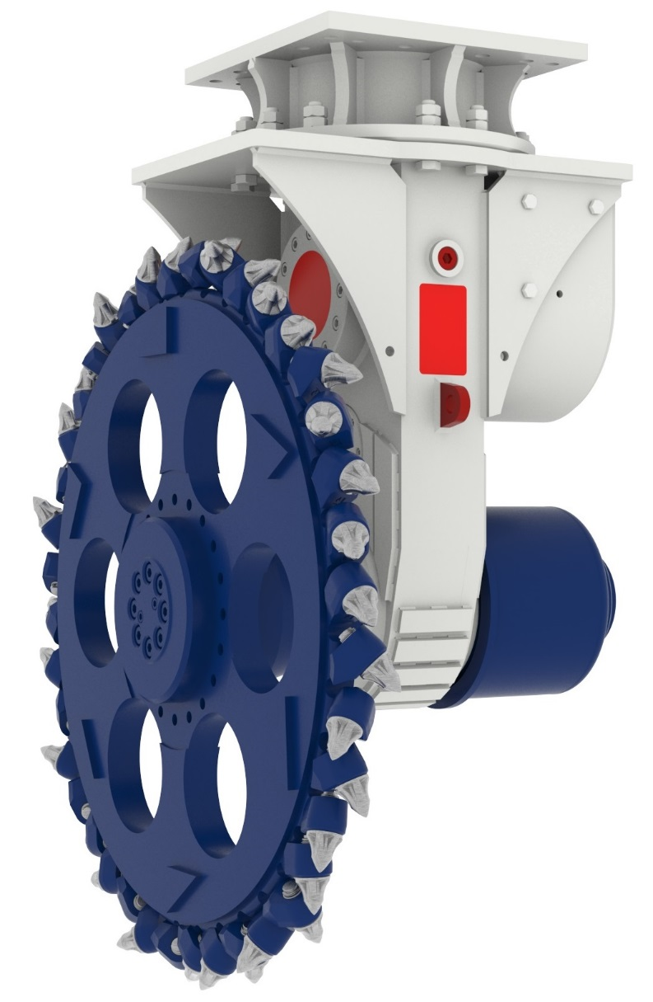
Drum Cutters with Cutting Wheel
Features ER cutter with cutting wheel
Intermediate bracket
for manual rotation
allowing off-set cutting
Cutting wheel fixed on standard drive shaft
Protection cover
for output drive shaft

Slide 3
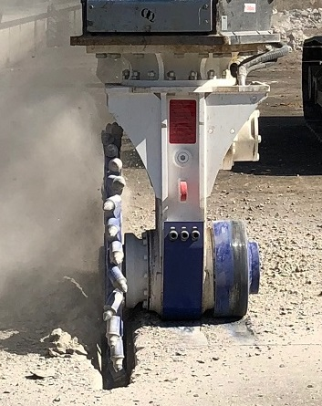
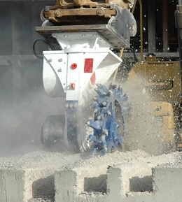
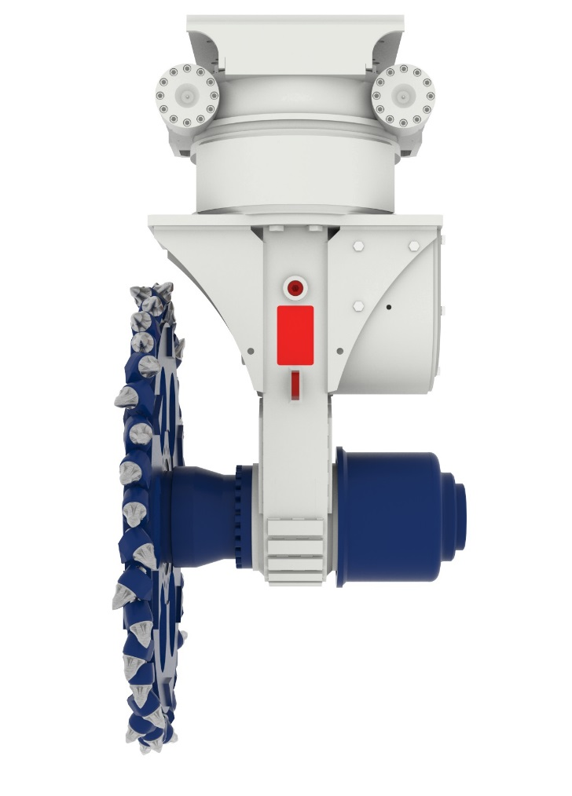
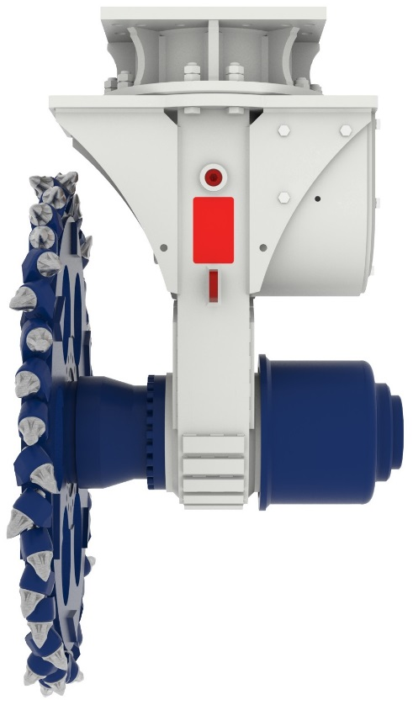
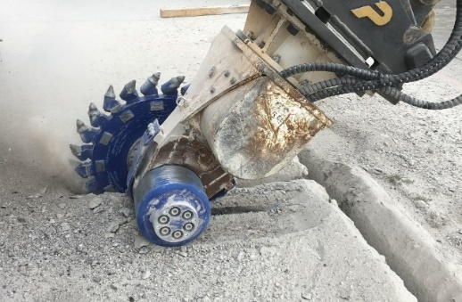
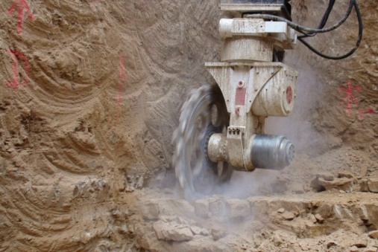
Drum Cutters with Cutting Wheel
ERC with cutting wheel
(hydraulic rotation unit)
ER with cutting wheel
(mechanical turntable bracket)

Slide 4
Cutting tools
Drum cutters

Slide 5
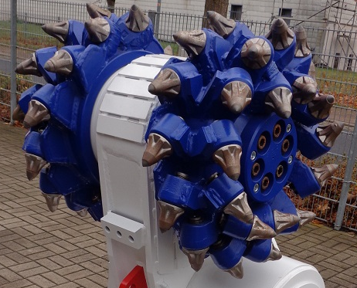
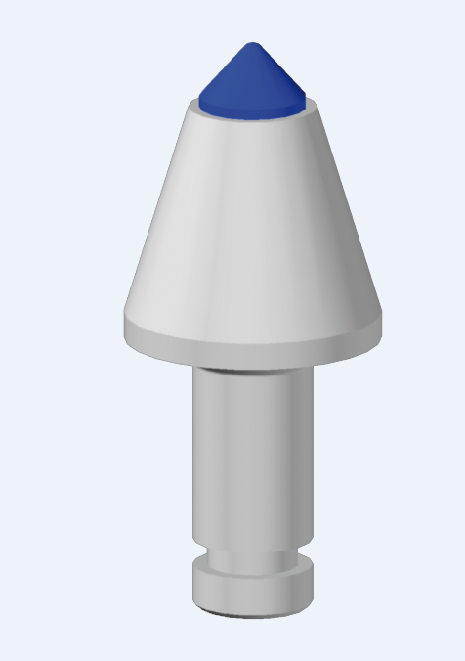
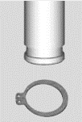
Hydraulic Attachment Tools
Drum cutters – Picks
Locking systems
Retainer sleeve on the shaft “H”
General structure
Tungsten carbide tip
Knock on retainer “K”
Head
Retaining clip “C”
Shaft
Circlip “S”
Locking groove
Quick snap “Q”
Up to 50% time saving compared to conventional systems

Slide 6
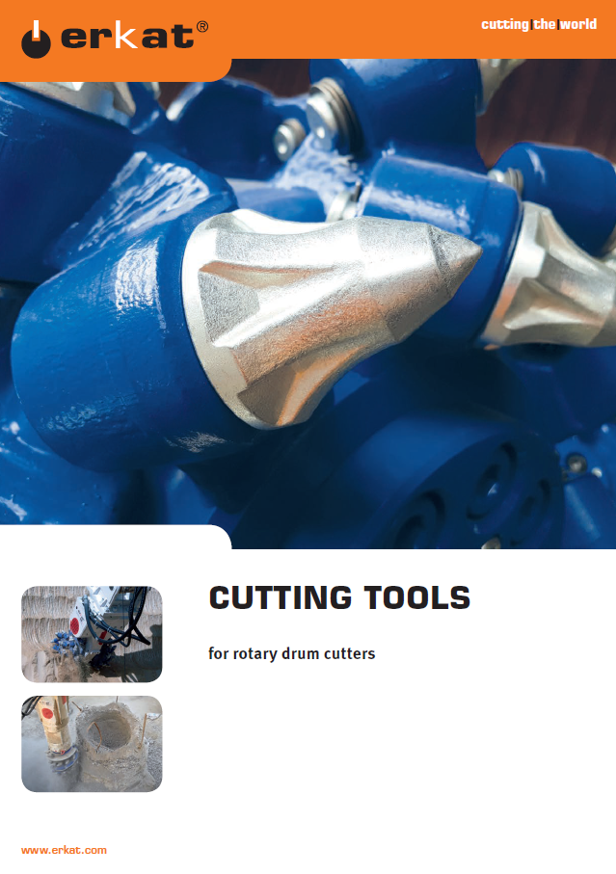
Picks / Cutting Tools
Carbide diameter/pick head height/ shaft length/shaft diameter
(1) ER 15/90/70/30: slim head, small carbide, soft rock
(2) ER 17/75/70/30: standard head, small carbide, soft to medium hard rock
(3) ER 22/75/70/30: standard head, medium carbide, medium to hard rock
(4) ER 25/77/70/30: standard head, big carbide, very hard rock, reinforced concrete
(5) ER 30/77/70/30: standard head, big cap carbide, abrasive soft to medium hard rock

Slide 7
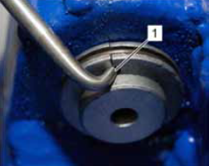
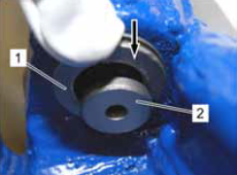
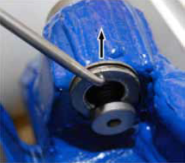
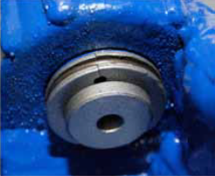
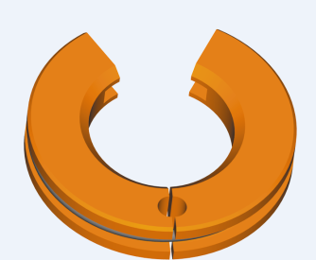
Hydraulic Attachment Tools
Drum cutters – QuickSnap “Q” (ER 600 – ER 3000)
For quick and easy pick exchange
Up to 50% time saving compared to conventional systems
Removal
Installation

Slide 8
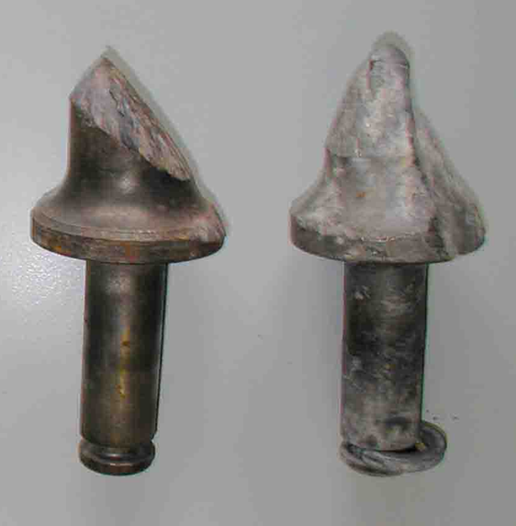
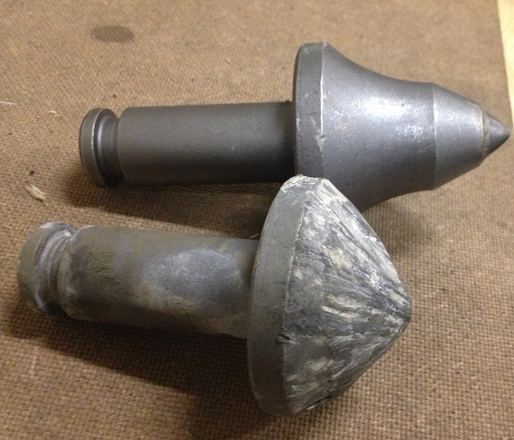
Hydraulic Attachment Tools
Cutting tools
Drum cutters – Pick wear
For even wear on all sides pick need to rotate freely in the pick box
Perfect pick wear when pick rotates freely in the pick box
Typical pick wear when pick can not rotate freely in the pick box

Slide 9
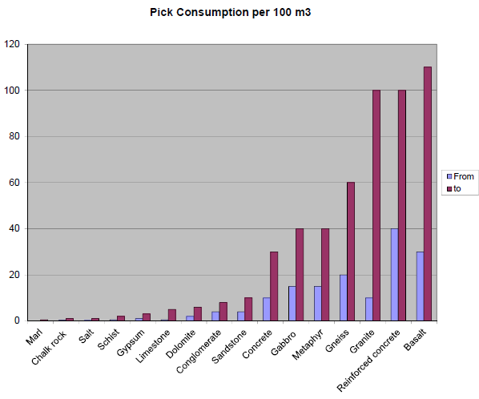
Hydraulic Attachment Tools
Cutting tools
Average pick wear in relation to different rock types
This chart is based on experience of our worldwide job sites and applications and is a recommendation only.
However, a guarantee cannot be given as there are other factors strongly influence these approximate values.
Besides the general rock characteristics also the size of the excavator and drive power, the oil flow and the stability as well as the operation of the machine itself may strongly influence the application area of the cutter models

Slide 10
Application examples
Drum cutters

Slide 11
MAIN APPLICATIONS
Trenching and pipeline construction
Concrete demolition, renovation
Construction pits and foundation excavation
Quarrying, mineral excavation
Tunnelling and mining
Road works
Foundation piling and pile head cutting
Underwater cutting
Steel industry
Tree stump cutting
Auger drilling

Slide 12
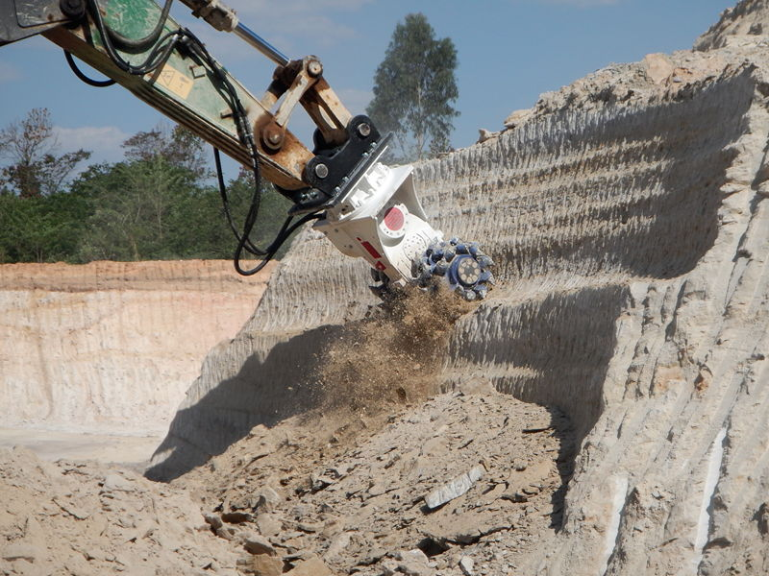
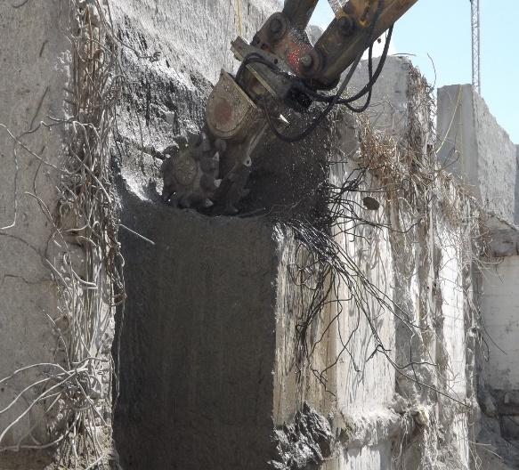
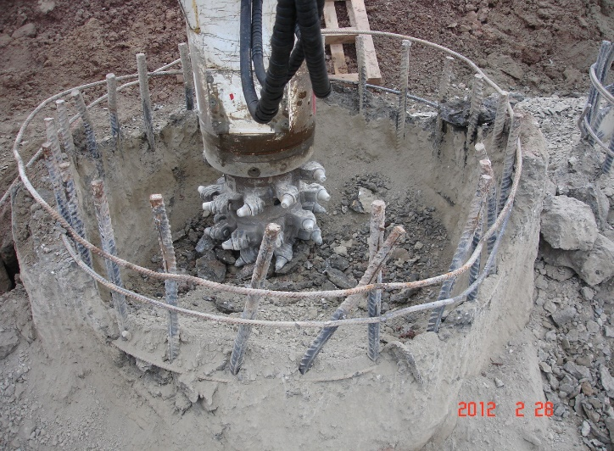
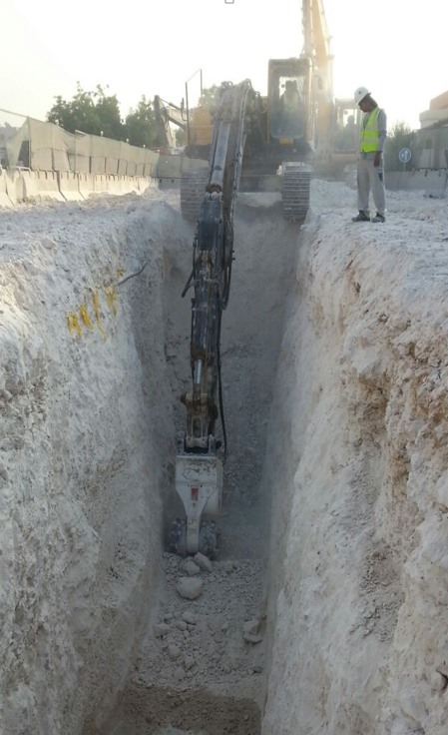
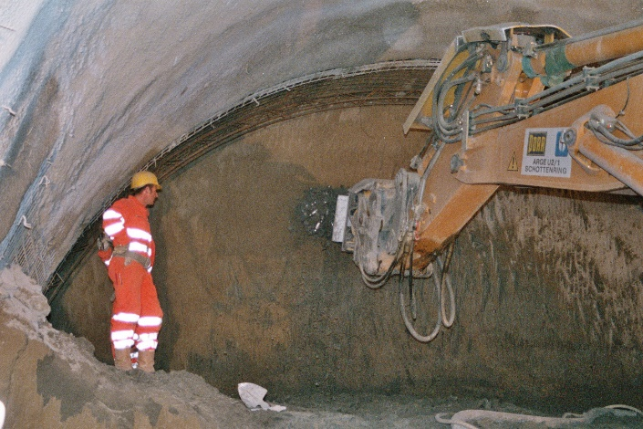
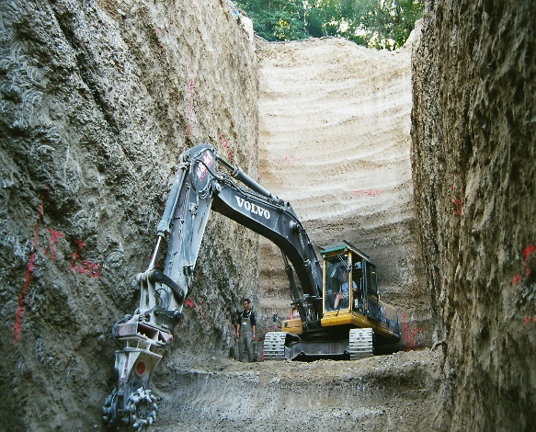
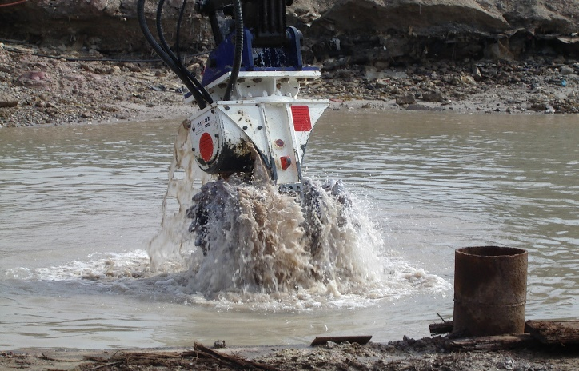
Drum Cutter Main Applications
Mining mass excavation
Demolition / rebuilding
Pilehead cutting
Trenching
Tunneling
Foundations
Underwater

Slide 13
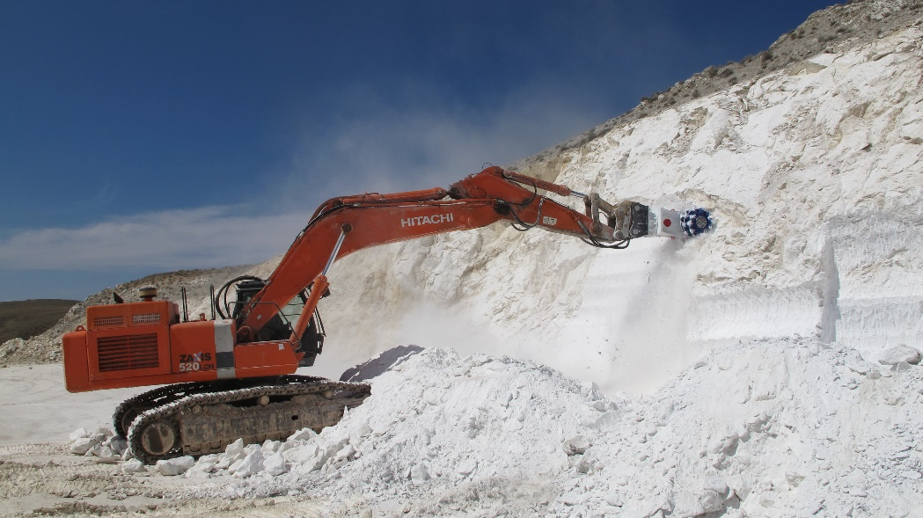
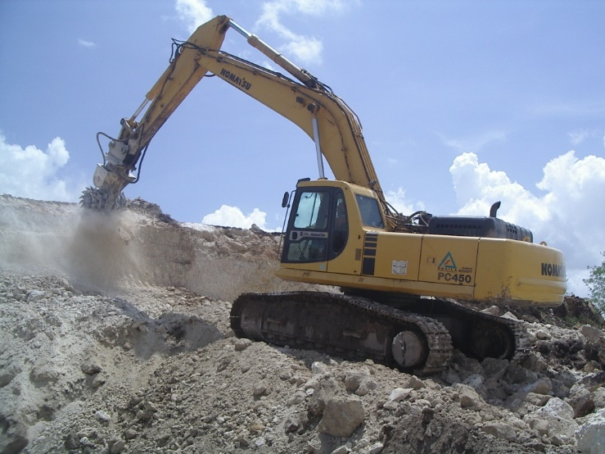
Hydraulic Attachment Tools
Rock excavation in quarry & mines
Required grain size?
Primary rock excavation in quarries

Slide 14
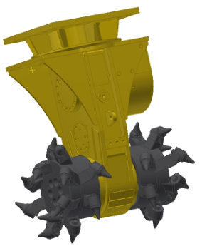
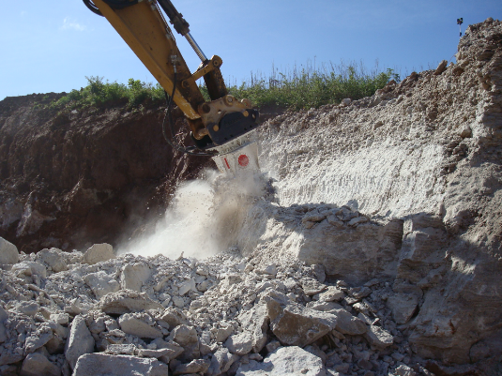
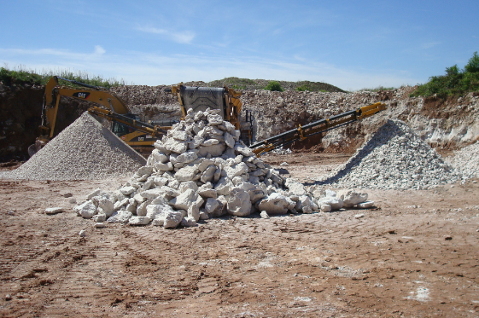
Hydraulic Attachment Tools
Rock excavation in quarry & mines
ER1500-G in gypsum quarry (Germany)
Required grain size?
Gypsum head for soft rock up to 20 MPa
Primary rock excavation in quarries

Slide 15
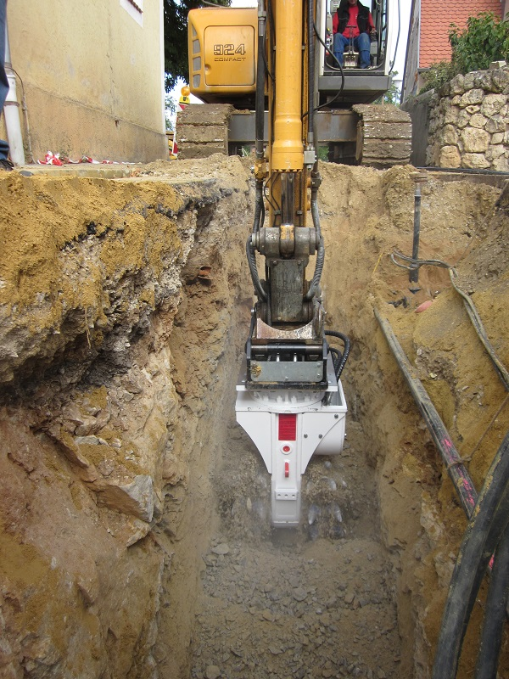
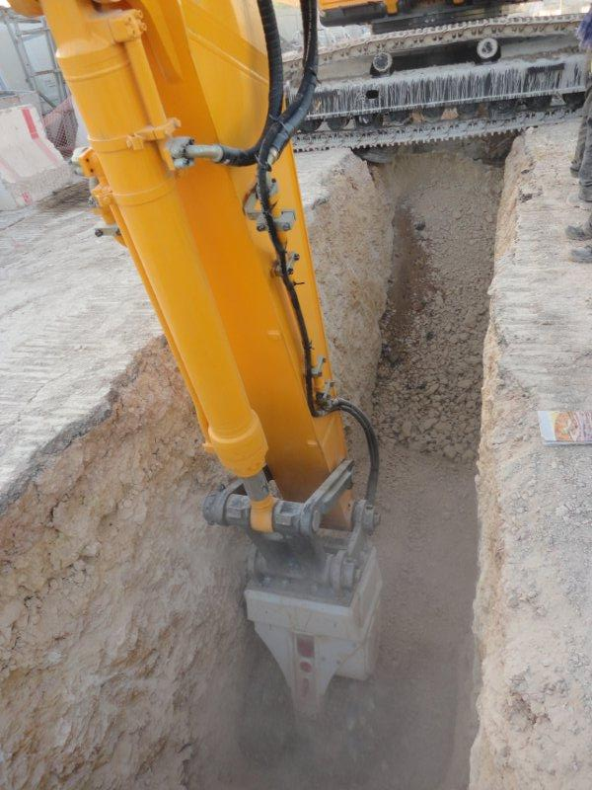
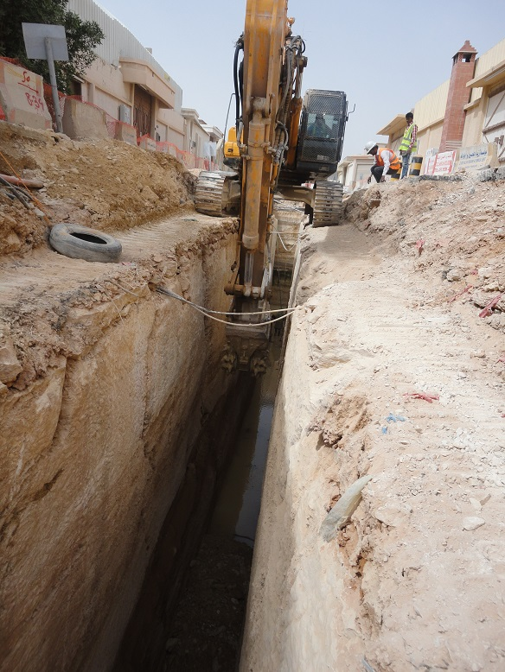
TRENCHING / PIPELINE CONSTRUCTION
TYPICAL APPLICATIONS

Slide 16
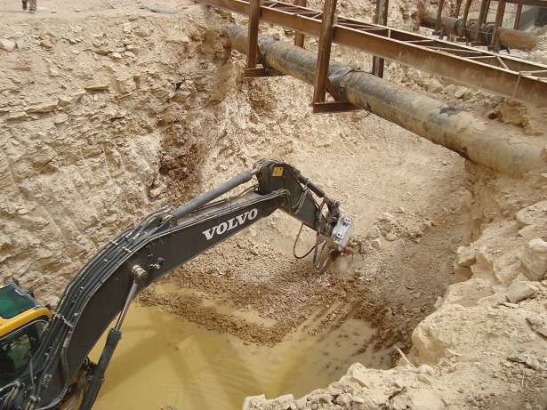
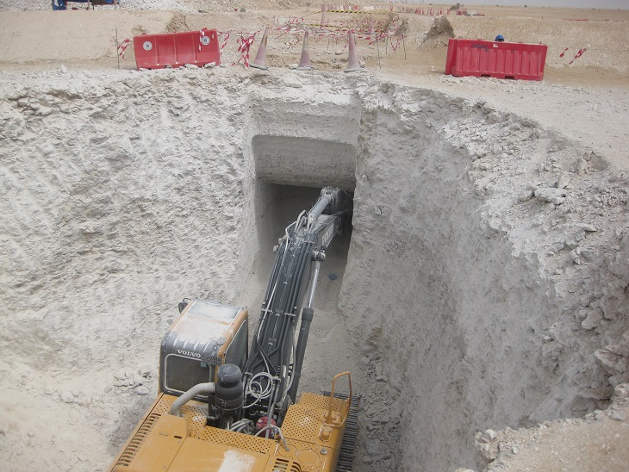
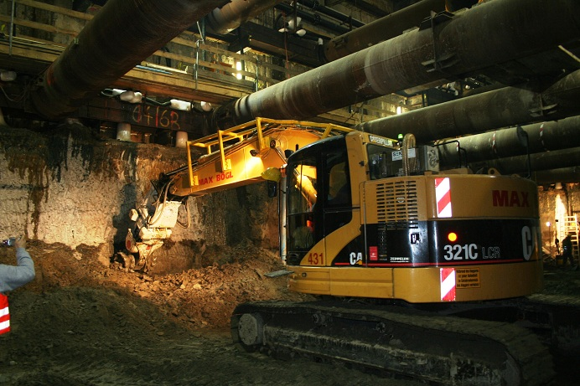
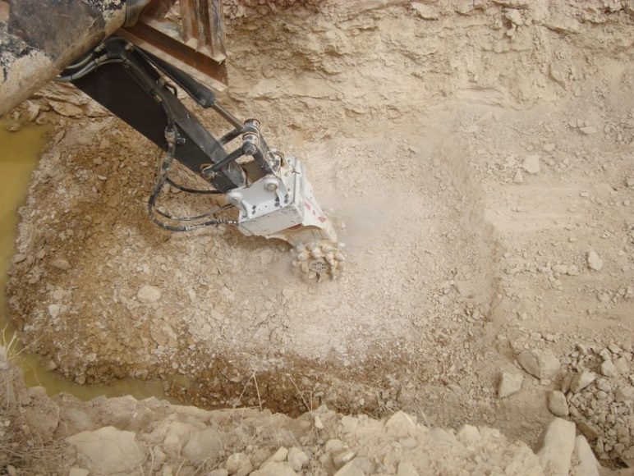
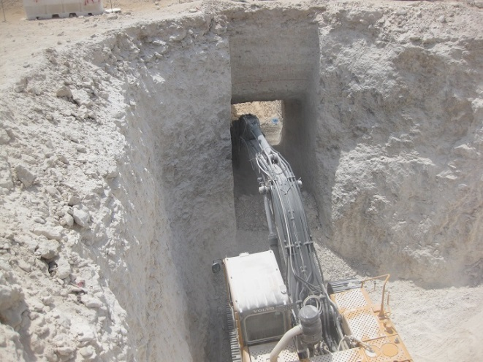
TRENCHING / PIPELINE CONSTRUCTION
crossing pipelines and undercutting

Slide 17
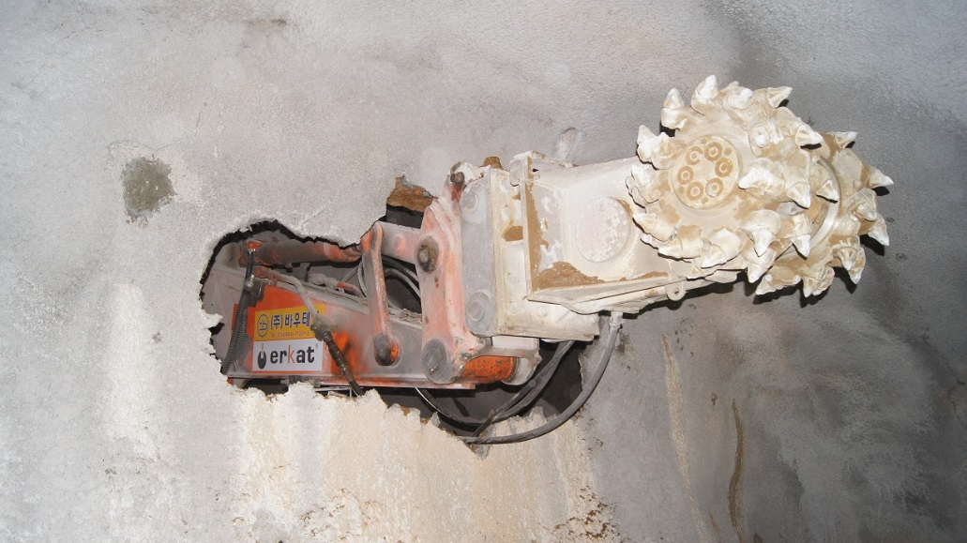
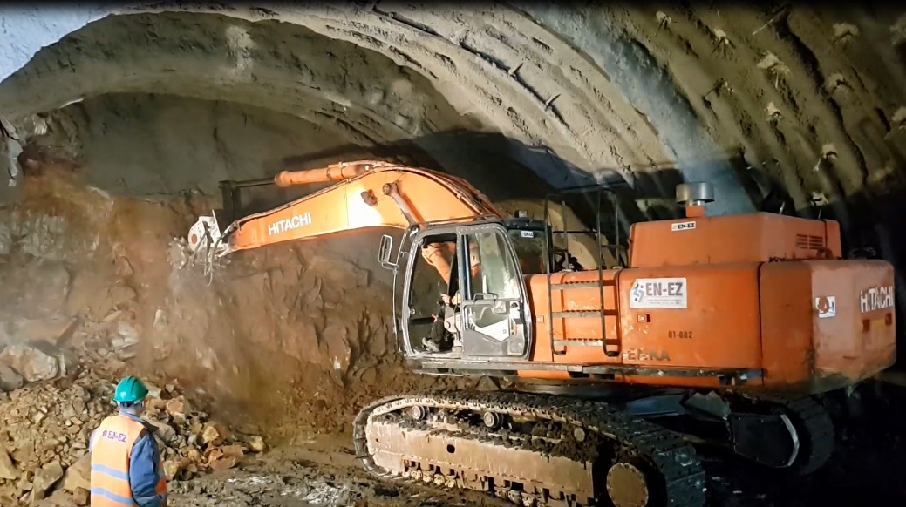
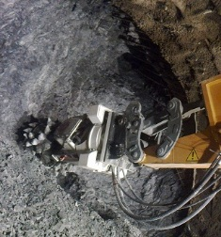
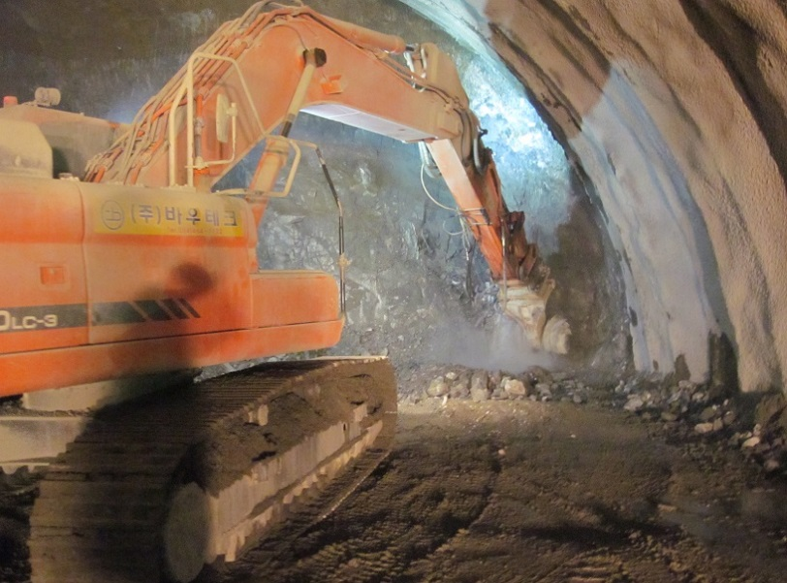
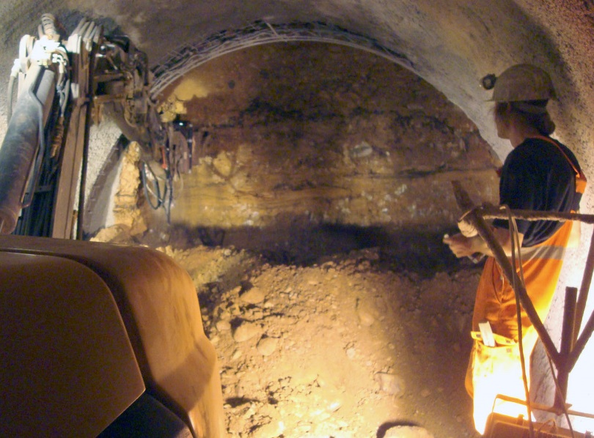
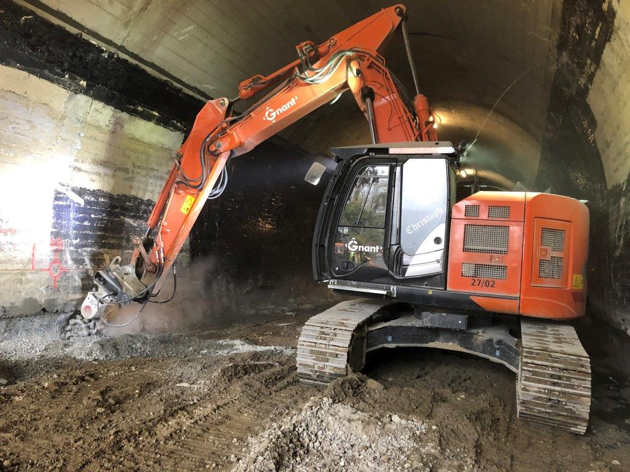
TUNNELING + MINING
TYPICAL APPLICATIONS

Slide 18
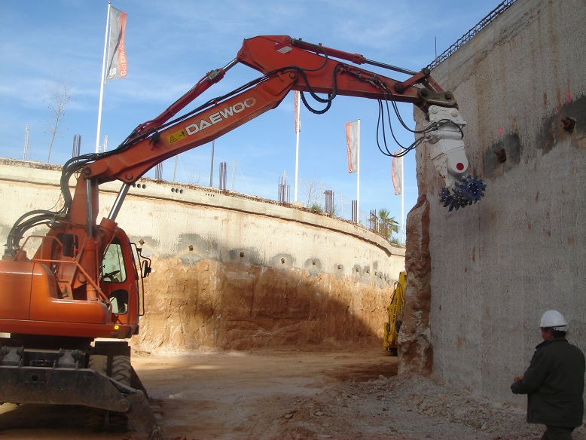
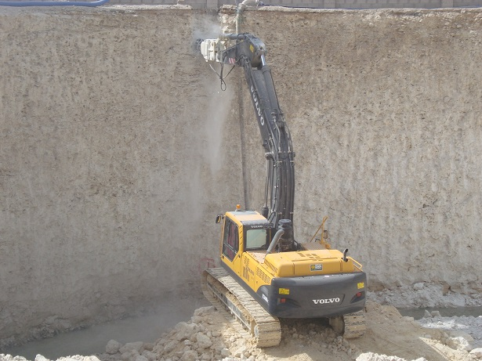
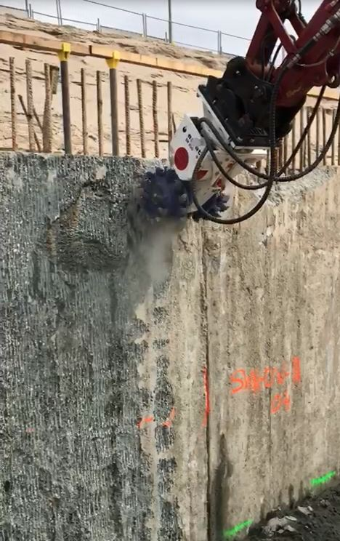
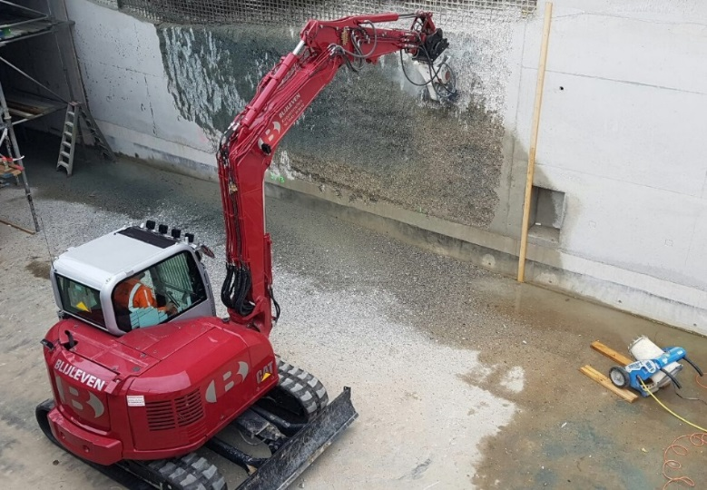
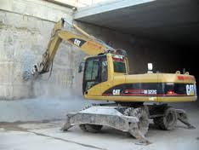
WALL SCALING / PROFILING
TYPICAL APPLICATIONS

Slide 19
DEMOLITION / CONCRETE RENOVATION
TYPICAL APPLICATIONS

Slide 20
ROADWORKS / ASPHALT CUTTING
TYPICAL APPLICATIONS

Slide 21
Construction shafts + foundation excavation
TYPICAL APPLICATIONS

Slide 22
QUARRYING / MINING / MINERAL PRODUCTION
TYPICAL APPLICATIONS

Slide 23
QUARRYING / MINING / MINERAL PRODUCTION
TYPICAL APPLICATIONS

Slide 24
SHAFT SINKING
TYPICAL APPLICATIONS

Slide 25
WOOD / TREE STUMP CUTTING
TYPICAL APPLICATIONS

Slide 26
TYPICAL SOIL MIXING APPLICATIONS

Slide 27
STEEL INDUSTRY
TYPICAL APPLICATIONS

Slide 28
Transverse Cutters with cutting wheel

Slide 29
Hydraulic Attachment Tools
Underwater application
Remote controlled excavator off-shore up to 2.500m depth

Slide 30
Hydraulic Attachment Tools
Underwater application
ER650 for suction dredger

Slide 31
Hydraulic Attachment Tools
Underwater application
ER5000 for suction dredger

Slide 32
Hydraulic Attachment Tools
Pile head cutting with ERL drum cutter

Slide 33
Hydraulic Attachment Tools
Pile head cutting with ERL drum cutter

Slide 34
Hydraulic Attachment Tools
Narrow trechning with ERL drum cutter

Slide 35
Hydraulic Attachment Tools
Auger drilling

Slide 36
Hydraulic Attachment Tools
Auger drilling

Slide 37
Hydraulic Attachment Tools
Auger drilling

