Slide 2

Typical Applications in Middle East Region
Drum cutters

Slide 3

Hydraulic Attachment Tools
Typical applications in Middle East region
Advantages of using ERKAT Drum Cutters
• Trench Width & Depth (Selecting the right tool)
• Starting from Asphalt
• Crossing Services
• Low Noise and Vibration
• Trench Finishing & Ground Level
• Manholes / Service Chambers
• Vertical Trenching
• Reusable Material
• Underwater
• Low maintenance

Slide 4
Hydraulic Attachment Tools
Typical applications in Middle East region

Slide 5
Hydraulic Attachment Tools
Typical applications in Middle East region
In many cases up to 75% of the Drum Cutter output material is fine grain and can be used as back fill material saving a lot of time and money spent to remove and transport the output material and to buy new material for backfill.

Slide 6
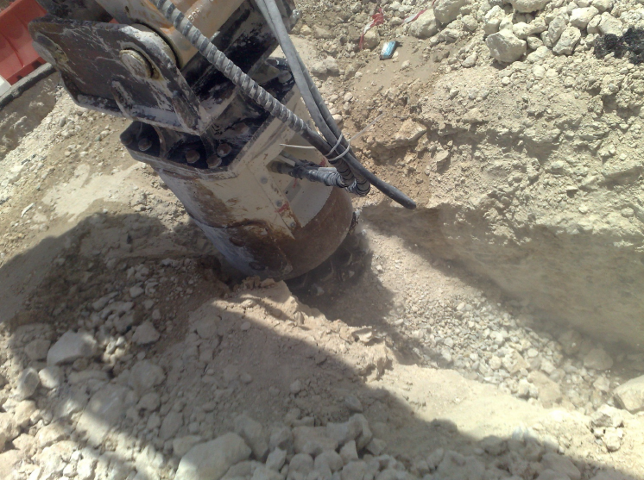
Hydraulic Attachment Tools
Typical applications in Middle East region

Slide 7
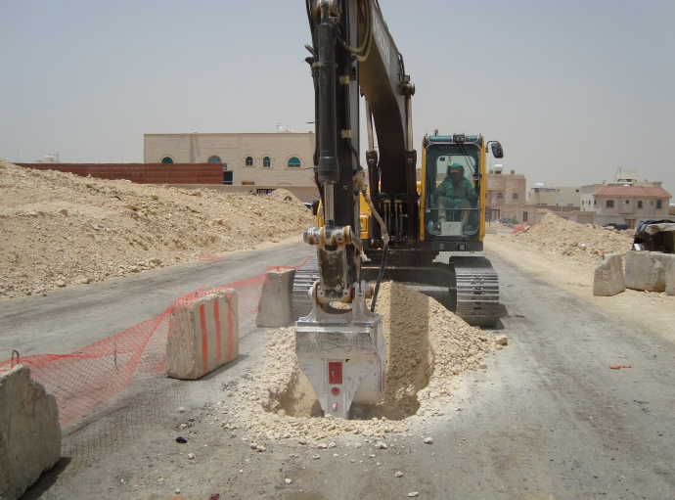
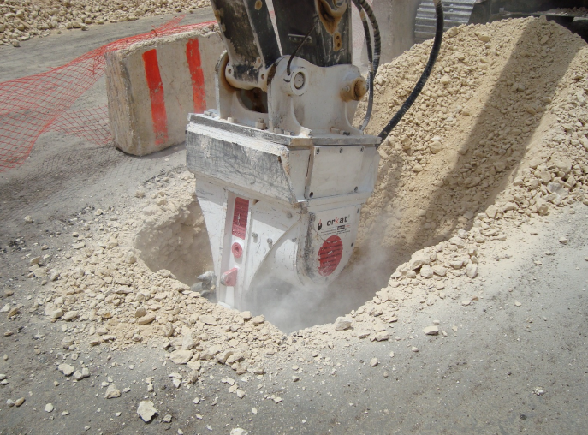
Hydraulic Attachment Tools
Typical applications in Middle East region
It is not required to remove the asphalt layer or cut it before starting trench excavation

Slide 8
Hydraulic Attachment Tools
Typical applications in Middle East region
Drum Cutters can cut easy under an existing service pipe in a trench very easy and can provide this works in a very short time.

Slide 9
Hydraulic Attachment Tools
Typical applications in Middle East region

Slide 10
Hydraulic Attachment Tools
Typical applications in Middle East region

Slide 11
Hydraulic Attachment Tools
Typical applications in Middle East region

Slide 12
Hydraulic Attachment Tools
Typical applications in Middle East region
Drum Cutters have the ability to cut rocks in horizontal direction which makes the job of cutting under services crossing your trench very easy even for huge pipelines.

Slide 13
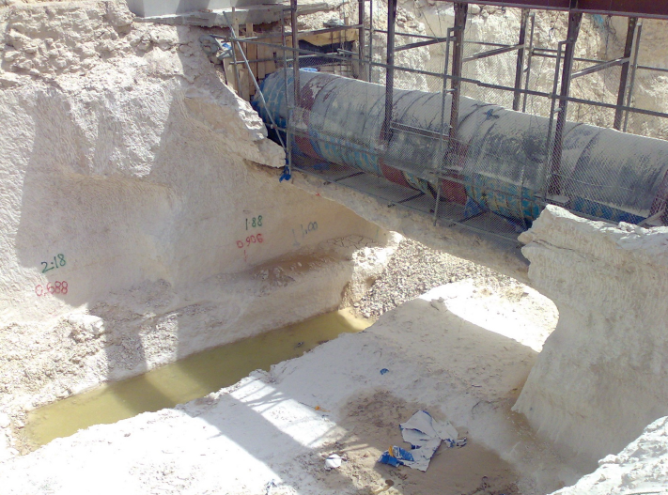
Hydraulic Attachment Tools
Typical applications in Middle East region
In some countries like Qatar it is permitted to use Erkat drum cutter to cut under live Oil & Gas pipes as our drum operate at very low vibration levels.

Slide 14
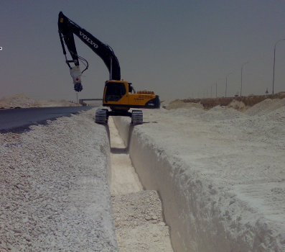
Hydraulic Attachment Tools
Typical applications in Middle East region
Drum Cutters can cut the trench exactly the size required with excellent ground level and avoid any over-excavation and finally also provide a very good ground leveling & surface finish for pipeline installation.

Slide 15
Hydraulic Attachment Tools
Typical applications in Middle East region
As a part of the trenching job and while trenching, Drum Cutters also excavate all the required service chambers.

Slide 16
Hydraulic Attachment Tools
Typical applications in Middle East region

Slide 17
Hydraulic Attachment Tools
Typical applications in Middle East region

Slide 18
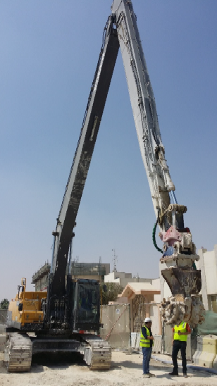
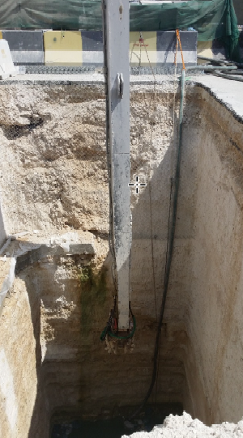
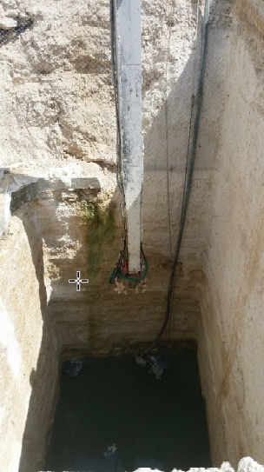
Hydraulic Attachment Tools
Typical applications in Middle East region
Cutting deep shafts as starting pits for microtunneling machines

Slide 19
Hydraulic Attachment Tools
Typical applications in Middle East region
Cutting vertical trenches

Slide 20
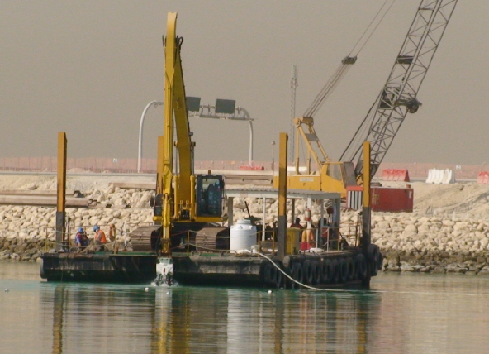
Hydraulic Attachment Tools
Typical applications in Middle East region
Drum Cutters can work up to depth of 30 meters under water
without any modification, Best tools for under water trenching.

Slide 21
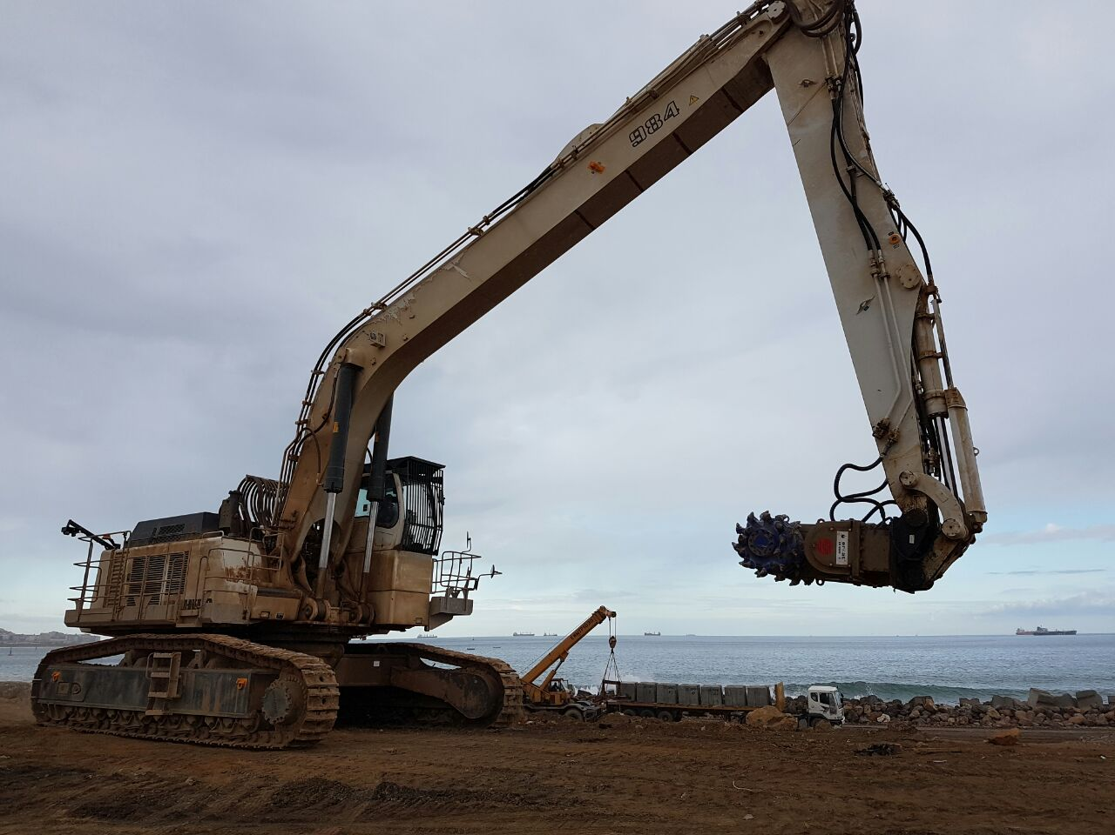

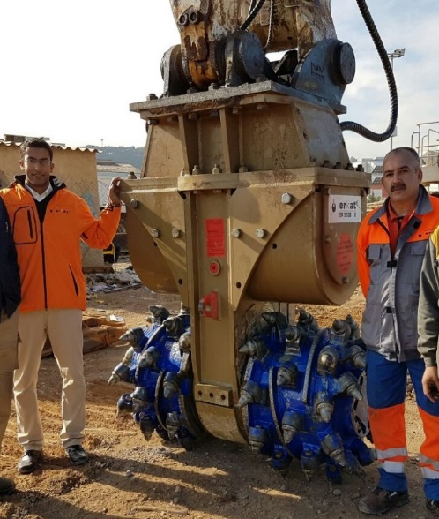

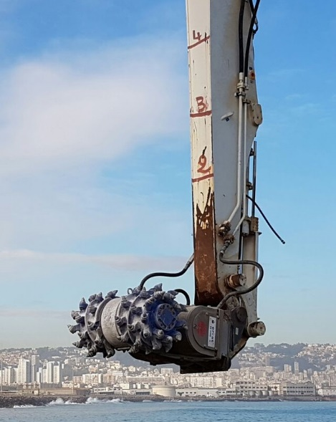
Hydraulic Attachment Tools
Typical applications in Middle East region
ER5500 on Liebherr R984 with long reach boom

Slide 22
Selecting the right model
Drum cutters

Slide 23
Hydraulic Attachment Tools
Selecting the correct drum cutter
Easiest way of selection by excavtor weight
MAIN QUESTIONS TO CUSTOMER
ER Models Drive Power Excavator Size
ER 40: 13 kW 0,6 – 2 t
ER 50: 18 kW 1 – 3 t
ER 100: 30 kW 3 – 7 t
ER 250: 45 kW 8 – 15 t
ER 600: 65 kW 10 - 18 t
ER 650: 80 kW 15 – 25 t
ER 1500: 120 kW 20 – 40 t
ER 1700: 120 kW 30 – 50 t
ER 2000: 160 kW 30 – 55 t
ER 3000: 200 kW 50 – 70 t
ER 5500: 400 kW 70 – 125 t
Kind of application?
Material to be cut: Type & hardness ?
Type of excavator available ?
Required productivity?
Hammer control circuit on excavator?
Excavator-side oil flow & pressure?
Installation / Adapter?

Slide 24
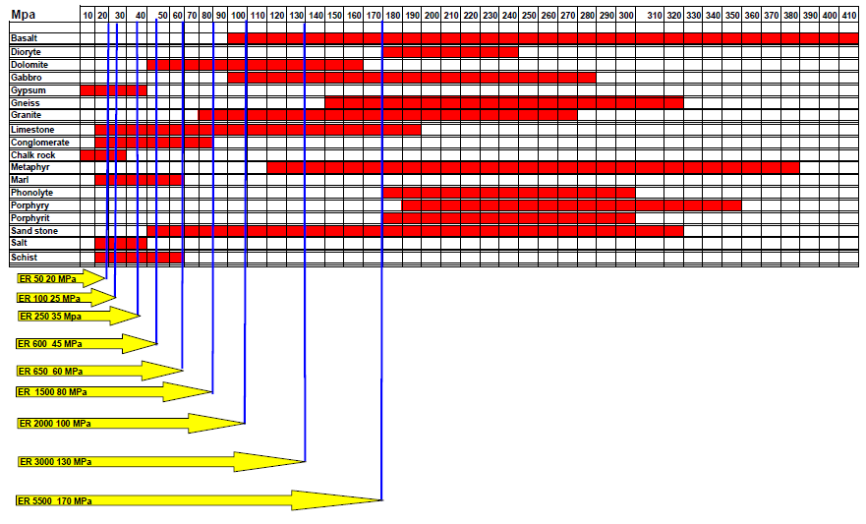
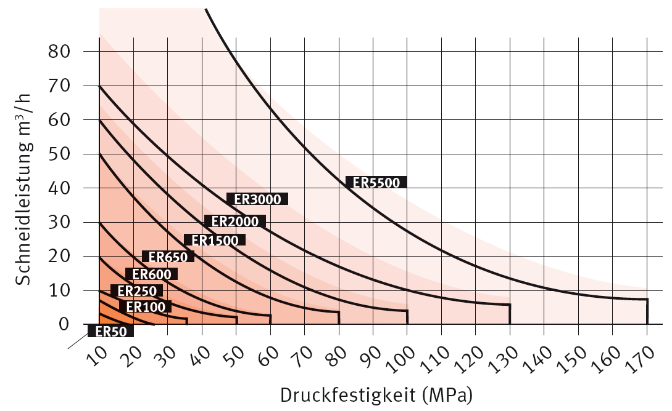
Hydraulic Attachment Tools
Selecting the correct drum cutter
Range of drum cutter operation in relation to the rock resp. rock hardness
Cutting rate ´(m³/h)
Rock Hardness (MPa)

Slide 25
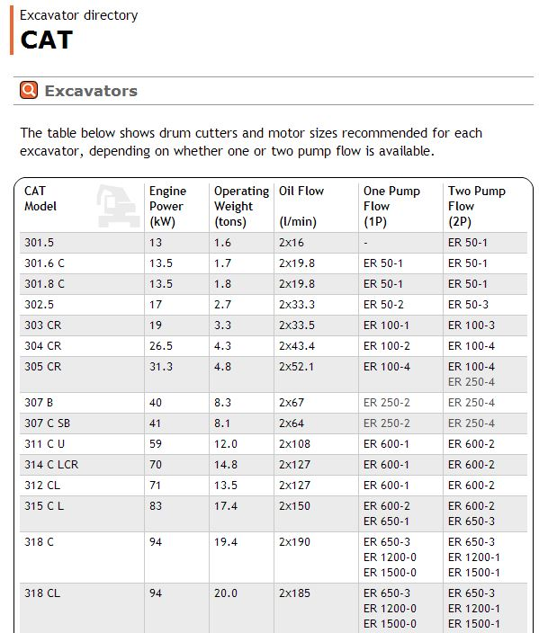
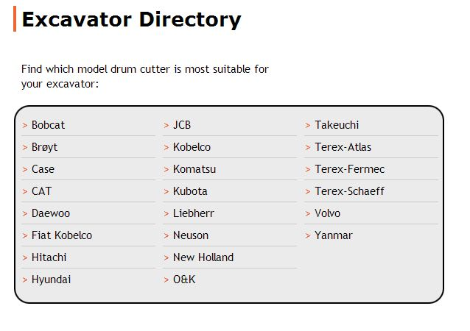
Hydraulic Attachment Tools
Selecting the correct drum cutter
Selection by using the excavator directory at Erkat homepage

