Slide 2
Non-Standard Versions
Drum cutters

Slide 3
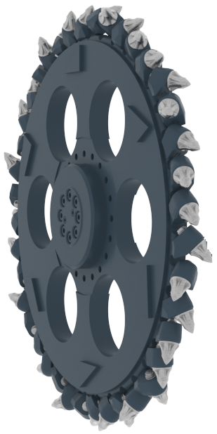
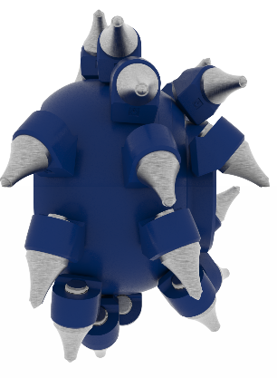
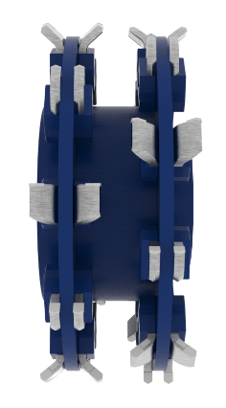
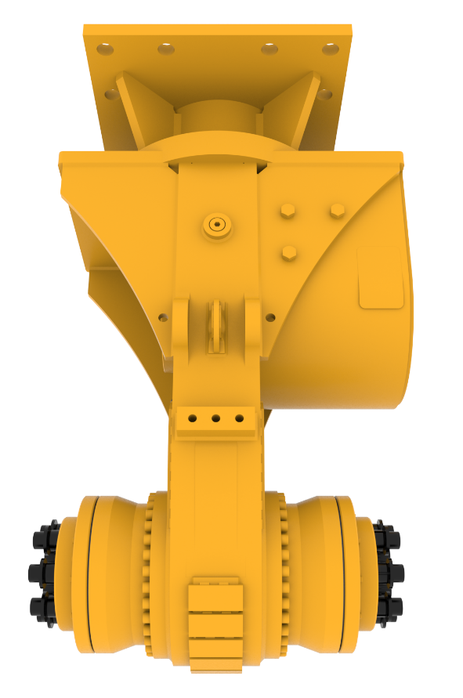
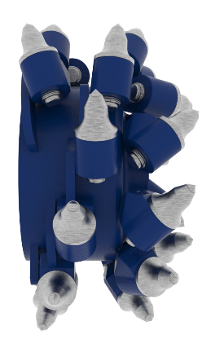
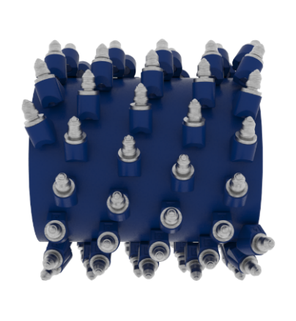
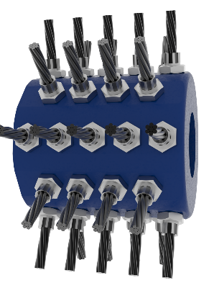
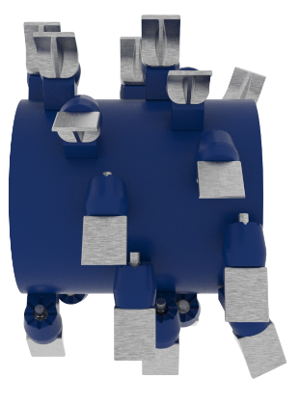
Non-Standard Drum Cutters
Principle of variations by modular design concept
Further drum types upon request
High production drum
Wood grinding drum
Slot cutting wheel
Standard cutting drum
Profiling drum
Brush drum
Soil mixing drum

Slide 4
Non-Standard Transverse Drum Cutters
Available variations
Cutting head variations | ER40 | ER50 ERC50 | ER100 ERC100 | ER250 ERC250 | ER600 ERC600 | ER650 ERC650 | ER1500 ERC1500 | ER1700 ERC1700 | ER2000 ERC2000 | ER3000 ERC3000 | ER5500
Cutting wheel (CW) |  | X | X | X | X | X | X | X | X | X
Brush drums (B) | X | X | X | X | X | X
Profiling heads (P) |  |  |  | X | X | X | X | X | X | X
Tunneling heads (TU) (straight) |  |  |  |  |  | X | X | X | X
Tunneling heads (T) (conical) |  |  |  |  |  |  | X | X | X
Excavation / production heads (G - straight) |  |  |  |  |  | X | X | X | X | X | X
Excavation / production heads (G - ball shape) |  |  |  |  |  |  | X | X | X | X | X
Soil mixing heads (M) |  |  |  |  | X | X | X | X | X
Wood grinding heads (W) |  |  |  | X | X | X
Further options upon request

Slide 5
Options for ER Transverse Drum Cutters
Available options
Options | ER40 | ER50 ERC50 | ER100 ERC100 | ER250 ERC250 | ER600 ERC600 | ER650 ERC650 | ER1500 ERC1500 | ER1700 ERC1700 | ER2000 ERC2000 | ER3000 ERC3000 | ER5500
Water spray kit * | X | X | X | X | X | X | X | X | X | X | X
Dust suction cower * | X | X | X
Underwater / Ocean kit ** |  |  |  | X | X | X | X | X | X | X | X
Additional hardfacing of all pick holders ** |  |  |  |  | X | X | X | X | X | X | X
High temperature kit ** |  | X | X | X | X | X | X
Arctic / low temperature kit ** |  |  |  |  |  | X | X | X | X | X | X
Pro Bracket (for ER series only) * |  |  |  |  |  | X | X | X | X
Extension brackets * |  |  |  |  | X | X | X | X | X
Drain oil connection kit * | X | X | X | X | X | (X)
HATCON |  |  | X | X | X | X | X | X | X | X | X
* Will / can be delivered as separate item
** Only for new drum cutters delivered from the factory
Further options upon request

Slide 6
Options for ERL Axial Drum Cutters
Available options
Options | ER100-L | ER250-L | ER400-L | ER450-L | ER600-L | ERL700 | ERL1100 | ER1500-L | ER2000-L
Additional hardfacing of all pick holders ** | X | X | X | X | X | X | X | X | X
Underwater / Ocean kit ** | X | X | X | X | X | X | X | X | X
High temperature kit ** | X | X | X | X | X | X | X | X
Arctic version (low temp environment) ** |  | X | X | X | X | X | X | X | X
Extension console (long/short) |  | X | X | X | X |  |  | X
Axial drum cutter for tunnel shield |  |  |  |  | X | X
HATCON
** Only for new drum cutters delivered from the factory
Further options upon request

Slide 7
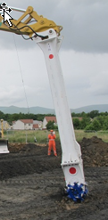
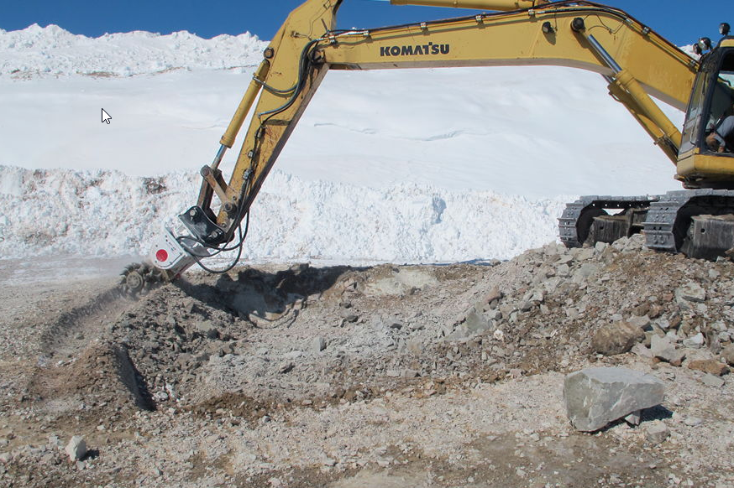
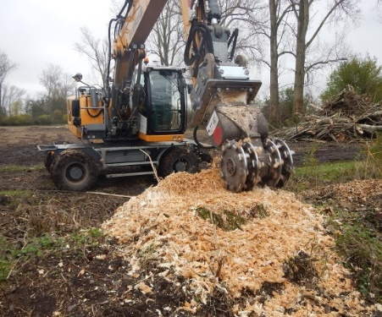
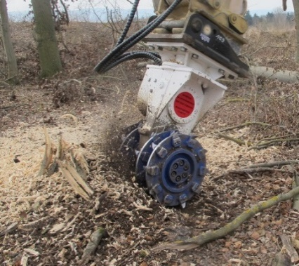
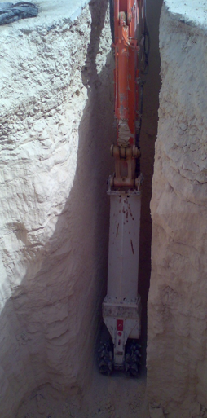
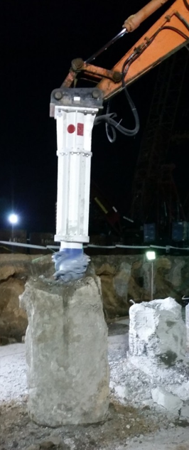
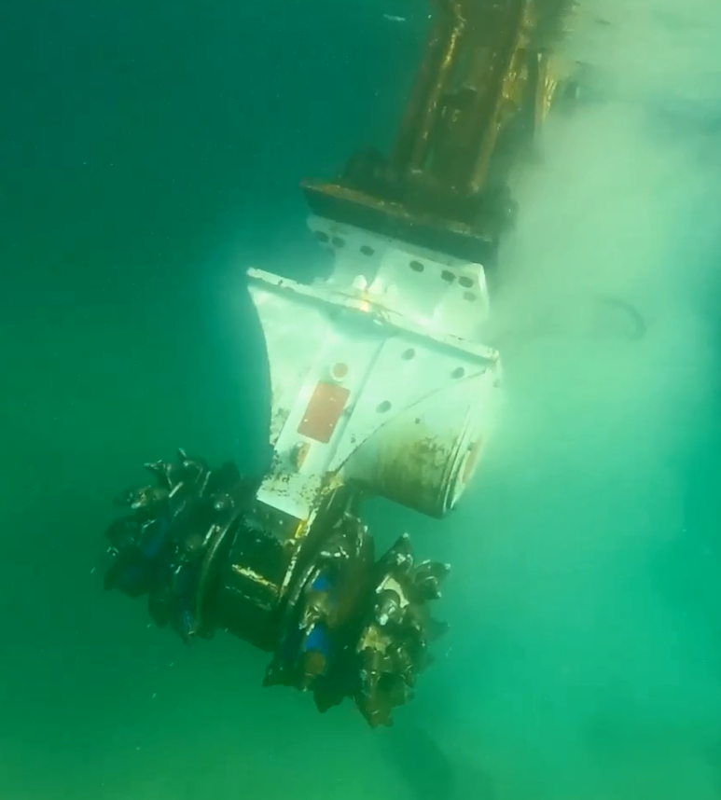
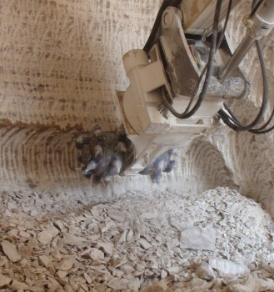
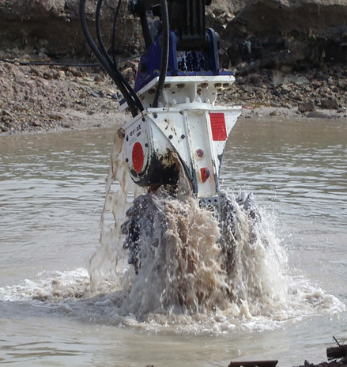
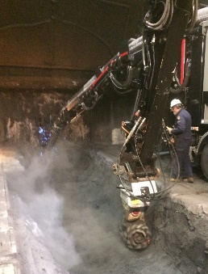
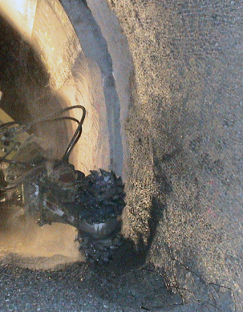
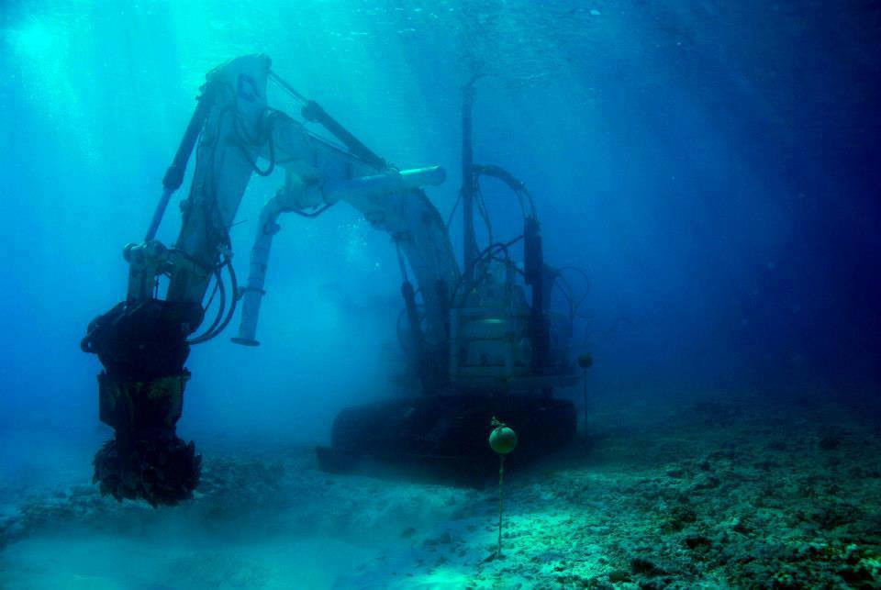
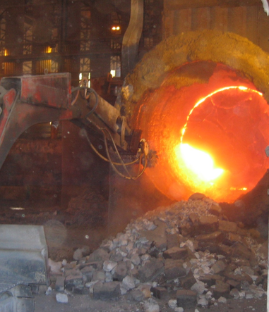
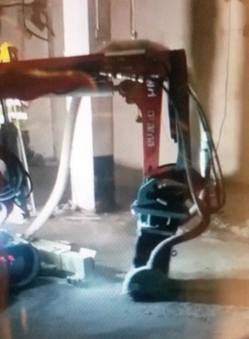
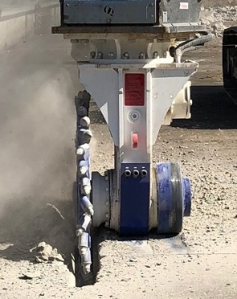
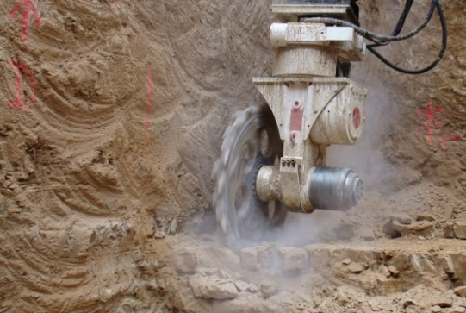
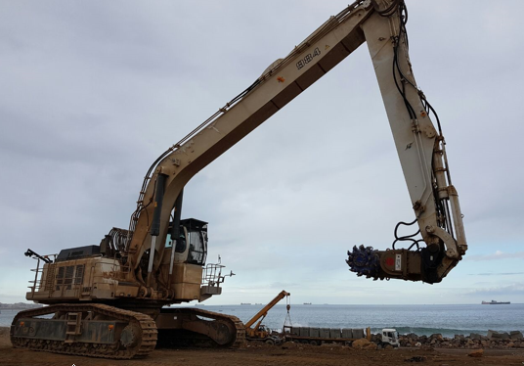
Options for Drum Cutters
Examples of options and solutions

Slide 8
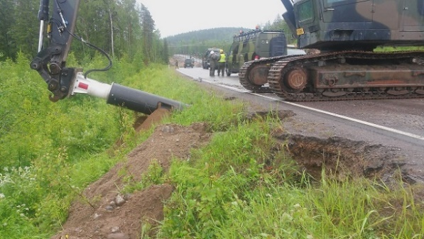
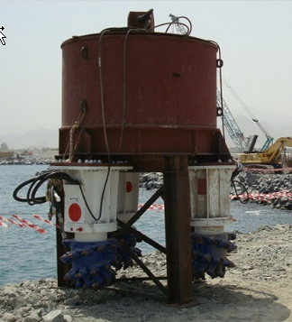
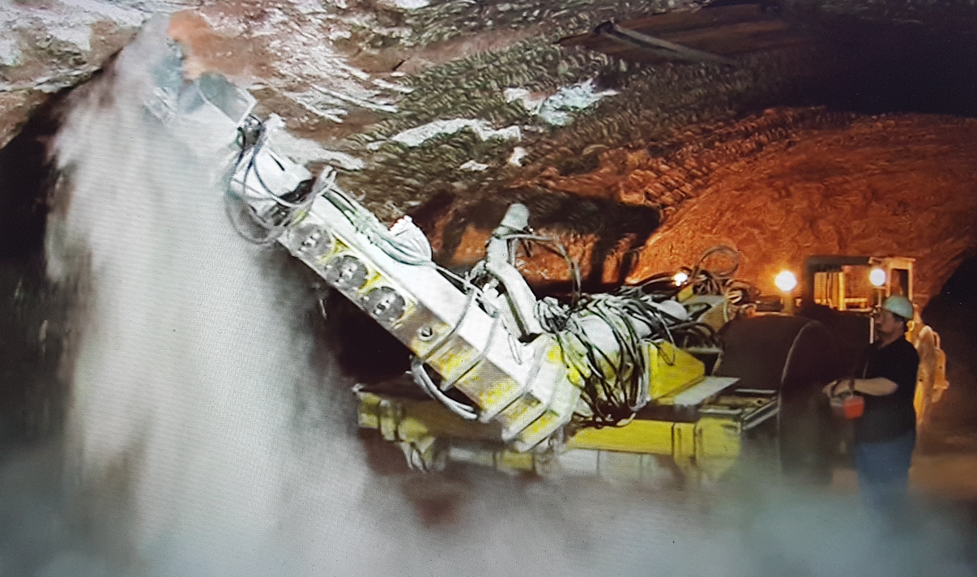
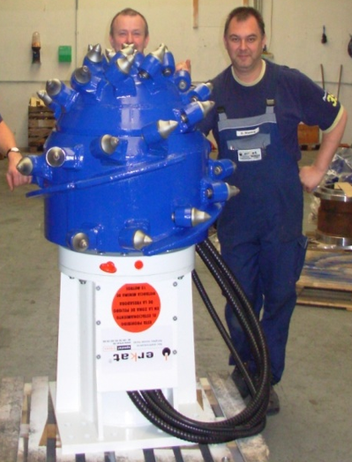
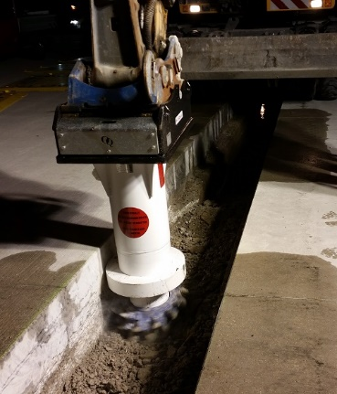
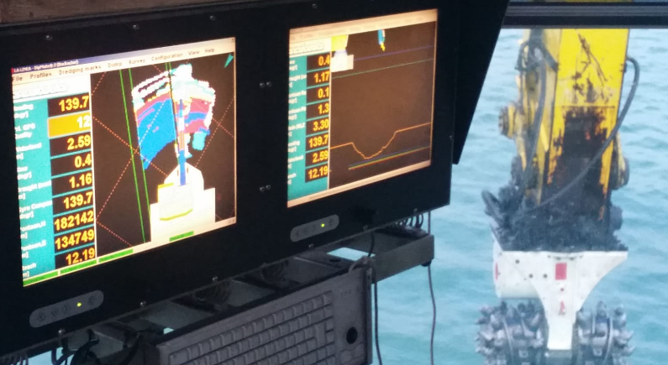
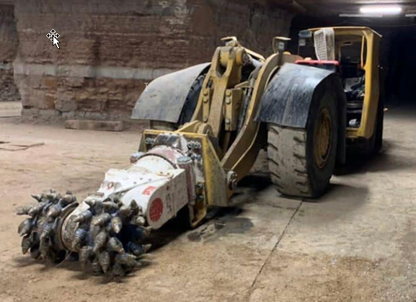
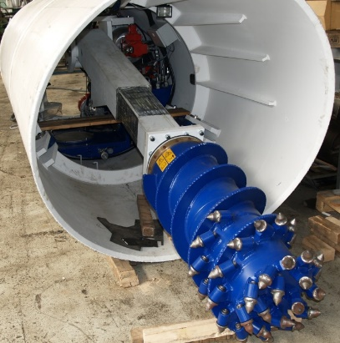
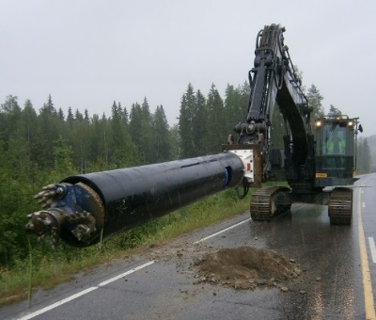
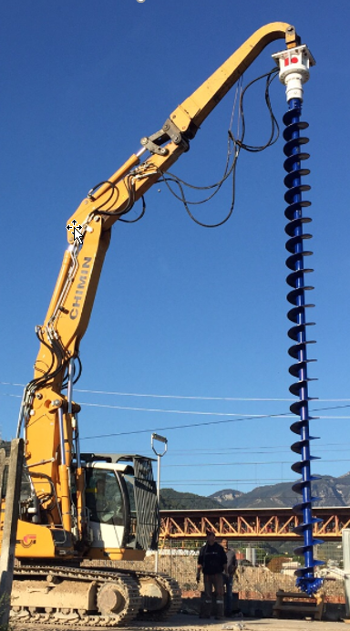
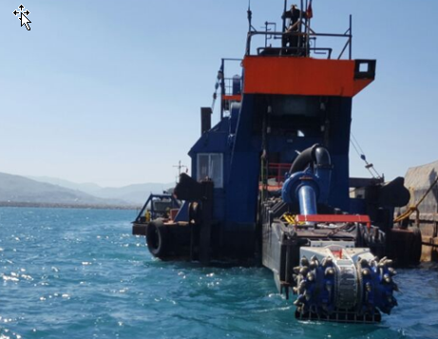
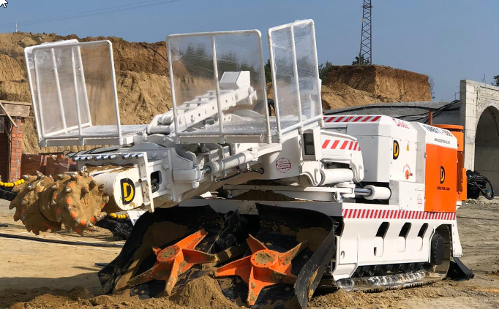
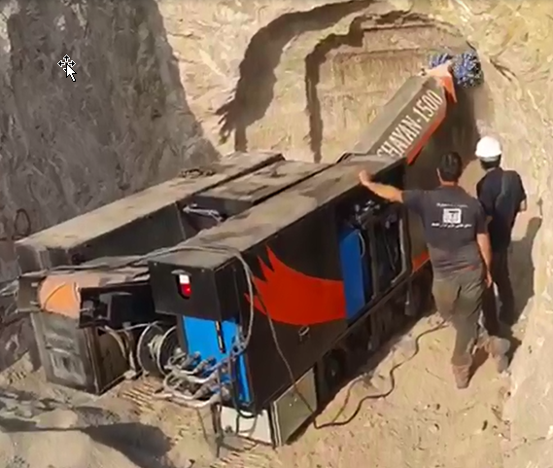
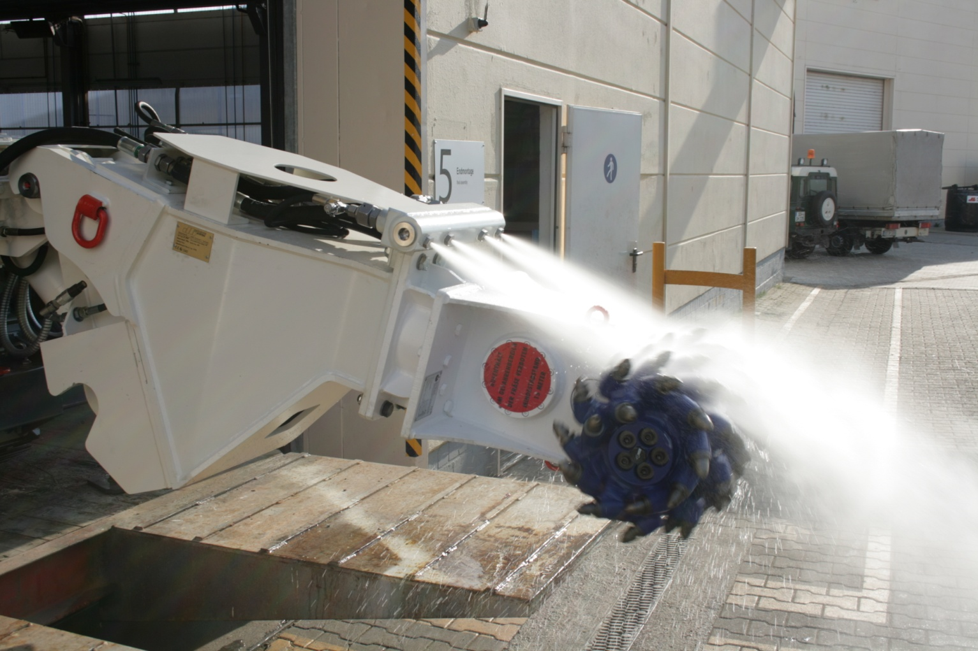
Options for Drum Cutters
Further options and solutions upon request – Just ask us !

Slide 9
Installation and Commissioning
Drum cutters

Slide 10
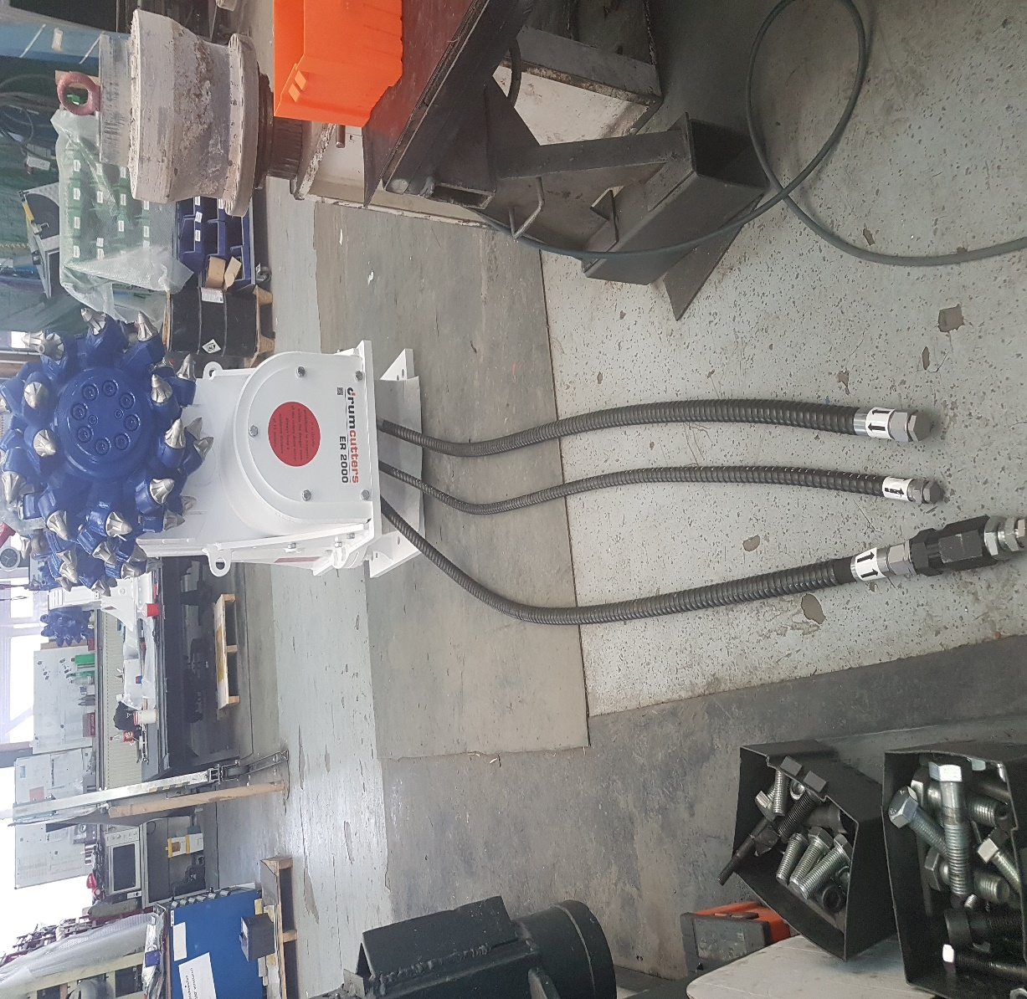
Hydraulic Attachment Tools
Technical Details
Cutting direction
Drain oil line (L)
Pressure line (P)
Return line (T)
with check valve

Slide 11
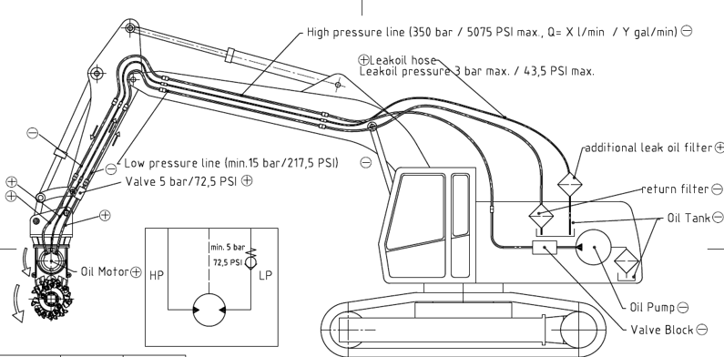
Hydraulic Attachment Tools
Installation & Commissioning
Overview of installation on hammer hydraulic circuit

Slide 12
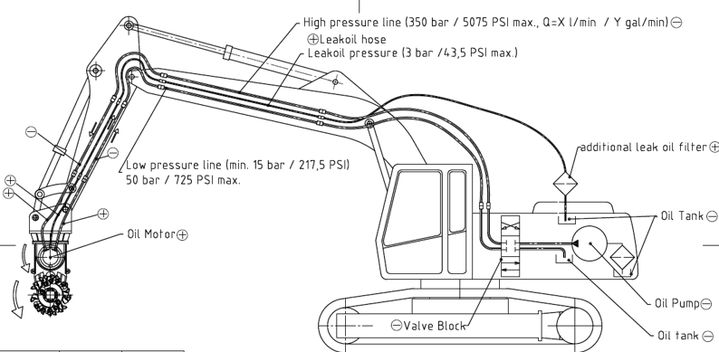
Hydraulic Attachment Tools
Installation & Commissioning
Overview of installation on shear hydraulic circuit

Slide 13
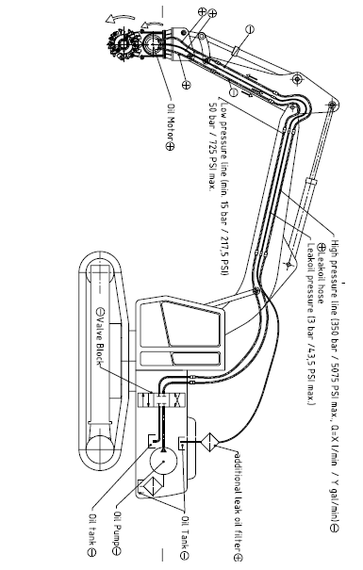
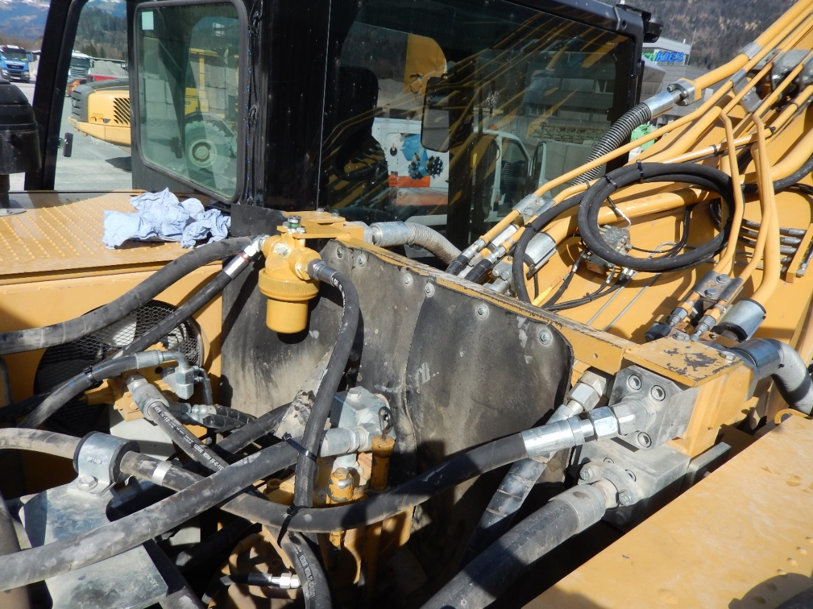
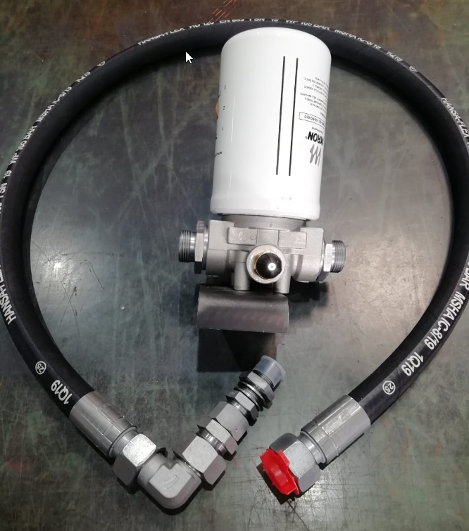
Hydraulic Attachment Tools
Installation & Commissioning
Installation of optional drain oil filter kit
(3 bar max. back pressure in darin oil line)
Drain oil filter kit

Slide 14
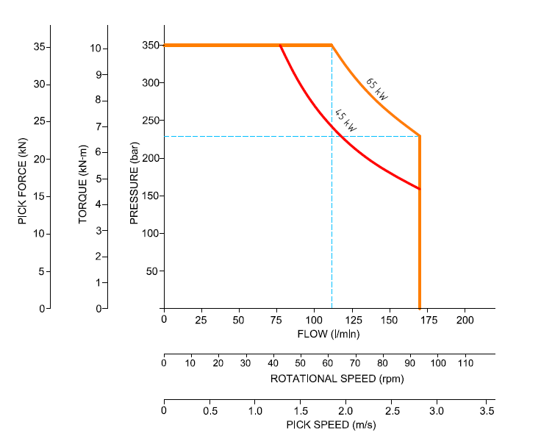
Hydraulic Attachment Tools
Installation & Commissioning
Correct set-up
The combination of oil flow and operating pressure must not exceed the Nominal Drive Power of the Drum Cutter
$$Operating pressure [bar]=\frac{Nominal Drive Power \left[kW\right]x 600}{Oil flow [l/min]}$$
$$Oil flow[l/min]=\frac{Nominal Drive Power \left[kW\right]x 600}{Operating pressure [bar]}$$
EXAMPLE
DC 1000
$$Hydraulic input[kW]=\frac{Oil flow [l/min] x Operating pressure [bar]}{600}$$
Recommended rotational speed/oil flow
(see operating manual)

Slide 15
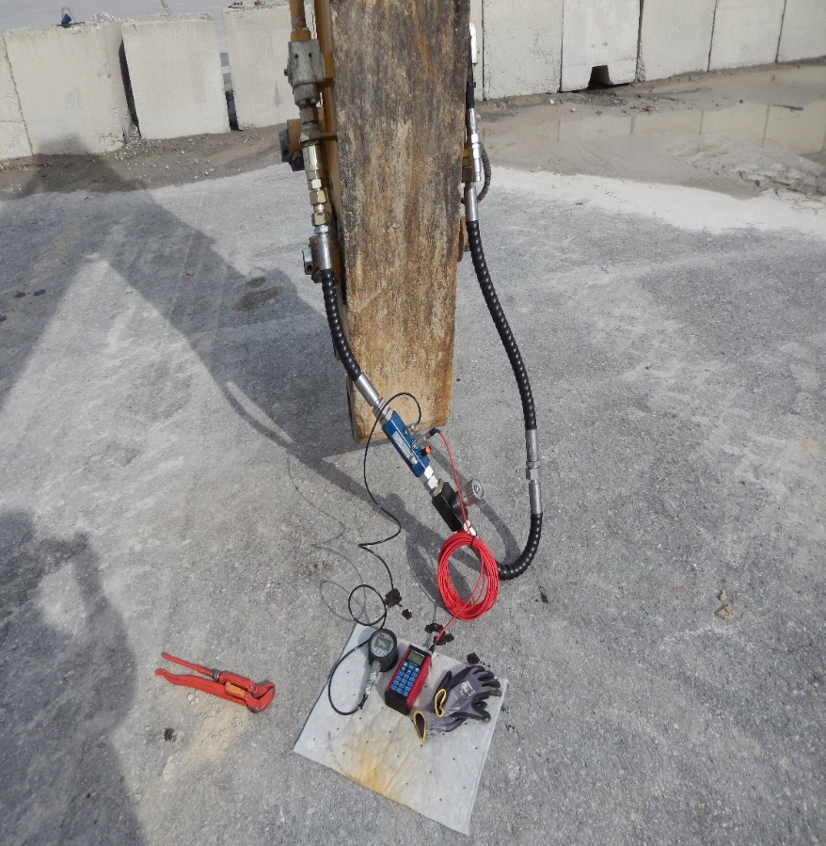
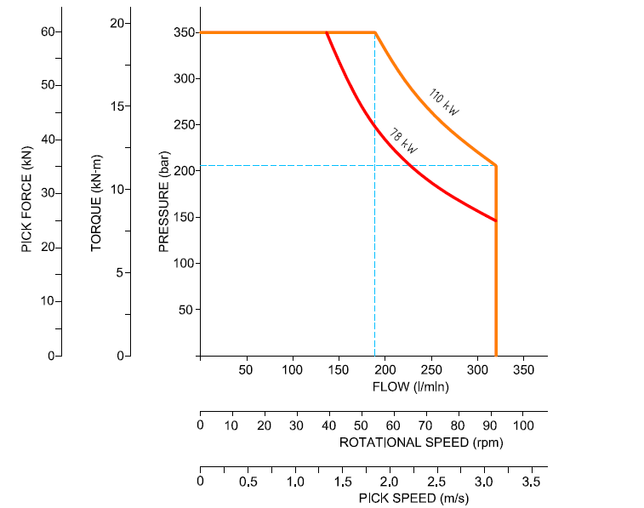
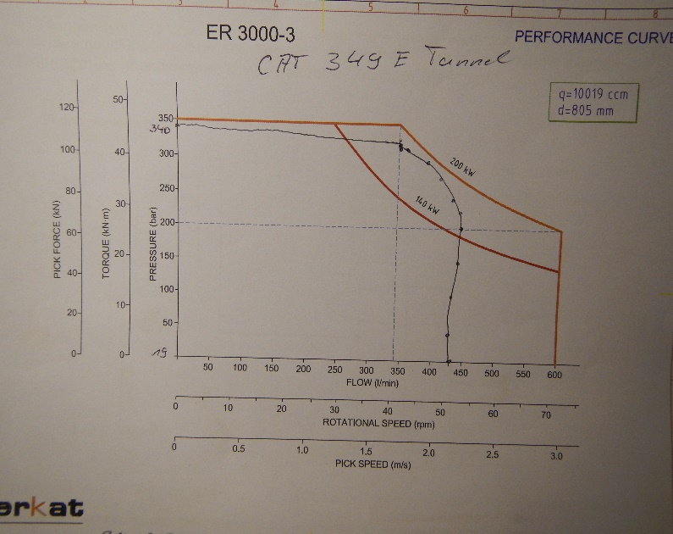
Hydraulic Attachment Tools
Installation & Commissioning
Installation of an ER1500
Recom. oil flow: 300 l/min
Min. oil flow: 190 l/min
Max. oil flow: 320 l/min
Max. pressure: 350 bar
Recom. drum speed: 75 U/min
Recom power set up: 80 kW
Max. drive power: 110 kW
ER1500-3

Slide 16
Competition
Drum cutters

Slide 17
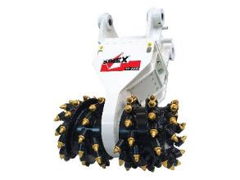
MAJOR COMPETITORS
SIMEX - ITALY
Transverse Drum Cutters
TF Series for carriers from 1.2 – 70 t
http://www.simex.it/en-gb/home-en
KINSHOFER - GERMANY
Transverse Drum Cutters
WS Series for carriers from 2 – 60 t
https://www.kinshofer.com/en/index.php/en/excavator-applications-1/construction-general-construction/ws-cutters
FORMER
ROCKWHEEL - UK
Transverse Drum Cutters
C/G/D Series for carriers from 0.7 – 125 t
Axial Drum cutters
AX Series for carriers from 15 – 38 t
http://www.rockwheel.com/en/
Cooperation with Webster Technologies Ltd., UK

Slide 18
MAJOR COMPETITORS
ANTRAQUIP - USA
Transverse Drum Cutters
AQ Series for carriers from 1 – 180 t
Axial Drum Cutters
AQL Series for carriers from 4 – 60 t
http://www.antraquip.net/
! Erkat remake !
MB CRUSHER - ITALY
Transverse Drum Cutters
MB-R Series for carriers from 3.5 – 35 t
https://www.mbcrusher.com/en/gb/
SANDVIK - FINLAND
Transverse Drum Cutters
MA Series for carriers from 20 – 45 t
https://www.rocktechnology.sandvik/en/products/mechanical-cutting-equipment/cutting-attachments/

Slide 19
MAIN COMPETITOR GLOBALY for transverse drum cutters
Wide range of drum cutters from 1 – 125 ton excavators
12 models with diffrenet drive systems, main range are the direct drive cutters
Range of drum cutters from 2.5 – 70 ton excavators
7 models with direct drive cutters
Range of drum cutters from 2.5 – 70 ton excavators
7 models with gear drive
Range of drum cutters from 3.5 – 35 ton excavators
4 models with special direct drive
Range of drum cutters from 20 – 65 ton excavators
3 models with planetary gear drive

Slide 20
MAJOR COMPETITOR
COMPETITOR >> KEMROC <<
KEMROC IS A FULLY ERKAT REMAKE
Start of promoton: February 2020
Erkat remake !
KEMROC – Germany
Previously ERKET (subsidary of ERKAT)
Transverse Drum Cutters
KR Series for carriers from 0.6 – 125 t
Axial Drum Cutters
KRL Series for carriers from 15 – 50 t
Rotator Units
KRM Series for carriers from 2 – 70 t
Notes:
20

Slide 21
MAJOR COMPETITOR
COMPETITOR >> KEMROC <<
ERKAT remake !
Gear Drive Transverse Cutter - KR series
Direct Drive Transverse Cutter - KRD series
13 Transverse drum cutter models with gear drive For excavators 0.6 to 125 tons (exactly the same range as ERKAT)
3 Transverse drum cutter models with direct drive for excavators 20 to 40 tons
Notes:
21

Slide 22
MAJOR COMPETITOR
COMPETITOR >> KEMROC <<
ERKAT remake !
Axial Drum Cutter - KRL series
4 Axial drum cutter models
for excavators 15 to 55 tons (same as ERKAT ERL700/1100 concept)
Rotator Units – KRM series
7 Hydraulic rotator units
for excavators 2 to 70 tons (same as ERKAT ERU cencept)
Notes:
22

Slide 23
MAJOR COMPETITOR
COMPETITOR >> ANTRAQUIP <<
ANTRAQUIP IS AN ERKAT REMAKE
of the older Erkat drum cutters (not updated)
Erkat remake !
ANTRAQUIP – USA
Transverse Drum Cutters
AQ Series for carriers from 1 – 150 t
Axial Drum Cutters
AQ-L Series for carriers from 4 – 60 t
Notes:
23

Slide 24
MAJOR COMPETITORS
DRUM CUTTER WITH DRIECT DRIVE
such as Simex, Rockwheel, MB, etc.
Very Simple Design, Drums directly mounted onto Drive Shaft of the Hydraulic Motor
Disadvantages:
Compared with Erkat, direct driven cutters typically have lower cutting forces and too many picks on the drums
Direct drive drum cutters mainly are used for soft soil application. In harder application the housing and bearing system is not robust enough.
Direct drive cutter do not have pick holder with wear resistant bushings
On the direct drive the hydraulic motor is located between both cutting heads and giving following disadvantages:
a). less space for bearings what is decreasing the stability of the output shaft.
b). radial vibrations due to the cutting process is going straight and without any
absorbing to the motor
c). assembling and disassembling of the motor is very complicated
d). On the cutters with direct drive it is not possible to change the volume /
displacement of the hydraulic motor to suit excavator hydraulics
e). cutting heads are wider than Erkat – heads
Some competitors of driect drive cutters give cutting froces and torques at max. 400 - 450 bar pressure, which is unrealistic as excavators only can provide max. 320 – 350 bar! Erkat`s spec data are based on realistic 350 bar !
The only advantage of direct drive cutters is the lower price, because of cheaper
production by missing gear box for the transmission of the torque from the motor
to the cutting head.

Slide 25
MAIN COMPETITOR
Difference between direct driven
and gear driven drum cutters
Rockwheel
Direct drive system, No gear
Hydraulic motor fitted on drum drive shaft
SIMEX
Direct drive system, No gear
Hydraulic motor fitted on drum drive shaft
ERKAT
Robust sturdy gear drive
Hydraulic motor “decoupled” from drum drive shaft,
Cutting drums fitted on massive output shaft system

Slide 26
MAIN COMPETITOR
COMPETITOR >> SIMEX <<
_{Simple Design}
Drums directly mounted onto the Drive Shaft of the Hydraulic Motor
_{No Gear Drive !}

Slide 27
MAJOR COMPETITOR
COMPETITOR >> ROCKWHEEL <<
_{No Gear Drive !}
Very Simple Design with direct drive concept
Drums mounted onto the drive shaft of the hydraulic motor
_{Empty housing,}
_{only hoses inside}
Notes:
27

Slide 28
MAJOR COMPETITOR
COMPETITOR >> ROCKWHEEL <<
Simple Direct drive,
hydraulic motor fitted on drum drive shaft, no reduction gear
Gear box housing is part of the hydraulic motor!
Notes:
28

Slide 29
MAJOR COMPETITOR
COMPETITOR >> ROCKWHEEL <<
Main Disadvantages
Rockwheel cutters have many picks on the drums, which cause less productivity
Drum pick boxes without wear resistant and replaceable sleeves
The motor is integrated in the front gear box housing, so in case of motor heavy failure the cpl. cutter housing needs to be replaced as well
The drum drive bearings are running in the hydraulic drain oil of the motor, so in case of motor damage also the bearing get disturbed by the motor debris
The motor is located between both cutting heads what is giving the following disadvantages: a) less space for bearings what is minimizing the stability of the output shaft b) radial vibrations due to the cutting process are going straight, without any absorbing to the motor c) assembling and disassembling of the motor is very complicated as motor is integrated in the internal drive d) Rockwheel cutters have no possiblity to change the displacement of the hydraulic motor to adapt to carrier machine
The integrated protection valve is a pressure relief valves which cuts off all hydraulic
pressure more than 280 bar. So the cutter is not working on 350 bar as mentioned in the catalogue. The cutter has in reality less cutting force ands is less aggressive in cutting.
Due to the 2 hydr. lines on the cutter (P+T) the motor case drain oil is feeded into the tank return line. So the max. back pressure in the retun line is restricted and the cutter can not be unsed on shear hydraulic system
The drain line system is protected with a pressure relief vale, which sprays into the environment !
Notes:
29

Slide 30
MAJOR COMPETITOR
COMPETITOR >> ROCKWHEEL <<
Problem of broken gear housing of direct drive cutter working in harder applications
(This machine is only 1,5 years old)

Slide 31
MAJOR COMPETITOR
COMPETITOR >> MB <<
_{No Gear Drive !}
Simple design concept with direct drive
Each drum driven by a separate hydraulic motor. Drums are not running synchron.
Very simple drum design and weak pick laycing
Notes:
31

Slide 32
MAJOR COMPETITOR
COMPETITOR >> MB <<
Main Disadvantages
MB cutters have only small pick size on too many picks on the drums, which cause less productivity
Picks boxes fixed on the drums with a poor welding
Drum pick boxes without wear resistant and replaceable sleeves
Double motor, i.e. one motor intergrated in each drum. High maintenance costs due to lack of synchronization of direct drive twin motors
The drum drive bearings are running in the hydraulic drain oil of the motor, so in case of motor damage also the bearing get disturbed by the motor debris
The motors are are located in the cutting heads what is giving the following disadvantages: a) less space for bearings what is minimizing the stability of the output shaft b) radial vibrations due to the cutting process are going straight, without any absorbing to the motor c) assembling and disassembling of the motors is very complicated as motor is integrated in the internal drive d) MB cutters have no possiblity to change the displacement of the hydraulic motor to adapt to carrier machine
Due to the 2 hydr. lines on the cutter (P+T) the motor case drain oil is feeded into the tank return line. So the max. back pressure in the return line is restricted and the cutter can not be used on shear hydraulic system
Notes:
32

Slide 33
MAJOR COMPETITOR
COMPETITOR >> ANTRAQUIP <<
ANTRAQUIP IS AN ERKAT REMAKE
of the older Erkat drum cutters (not updated)
Erkat remake !
ANTRAQUIP – USA
Transverse Drum Cutters
AQ Series for carriers from 1 – 150 t
Axial Drum Cutters
AQ-L Series for carriers from 4 – 60 t
Notes:
33

Slide 34
MAJOR COMPETITOR
COMPETITOR >> ANTRAQUIP <<
Notes:
34

Slide 35
MAJOR COMPETITOR
COMPETITOR >> ANTRAQUIP <<
Main Disadvantages
Poor remake of Erkat technology without knowing the technical background why the cutters are designed by Erkat as they are
Not having the technical updates of Erkat (just old style cutter copies)
Poor service network through local untrained service partners
Lack of application knowledge
No solutions for extraordinary applications
Trying to copy Erkat updates and new developments without any technical background
Notes:
35

Slide 36
MAJOR COMPETITOR
COMPETITOR >> KINSHOFER <<
sucessor of Terex-Schaeff drum cutters
Gear drive concept (likewise Erkat, but with gear reduction)
Notes:
36

Slide 37
Part of Epiroc group

