Slide 1
Drum Cutter Attachment
For
Tunneling Work
United Arab Emirates

Slide 3
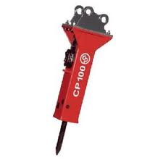
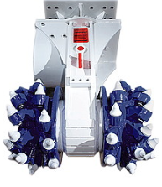
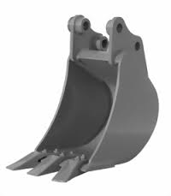
AREA OF APPLICATION FOR ROCK CUTTING
0 | 20 | 40 | 60 | 80 | 100 | 120 | 140 | 160 | 180 | 200 | 220 | 240
Compressive Rock Strength (MPa)

Slide 4
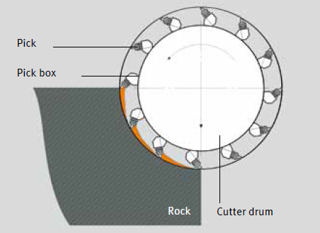
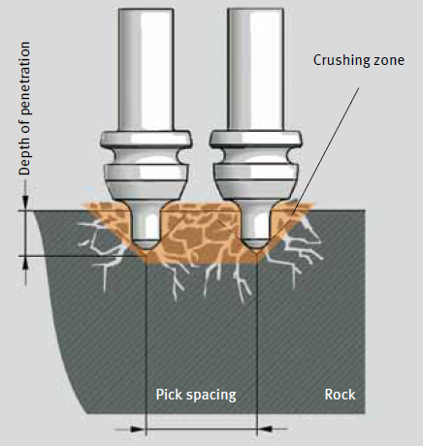
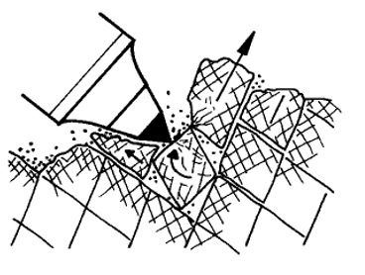
PRINCIPLE OF ROCK CUTTING

Slide 5
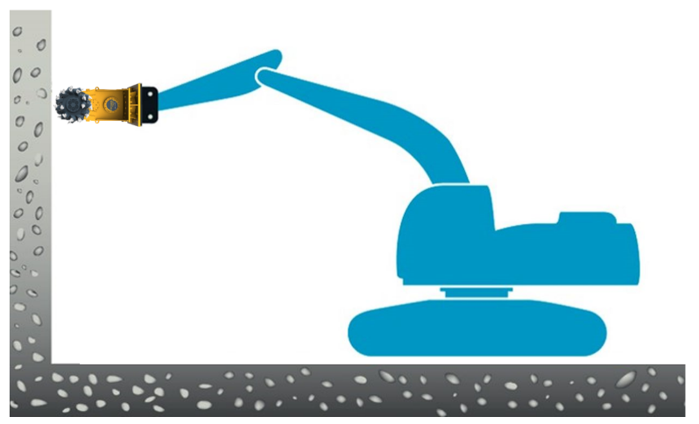
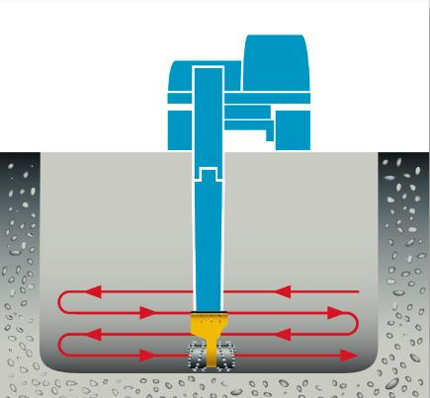
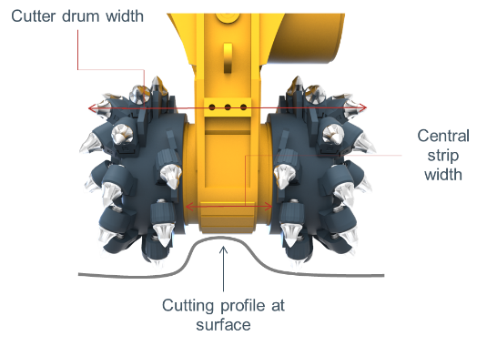
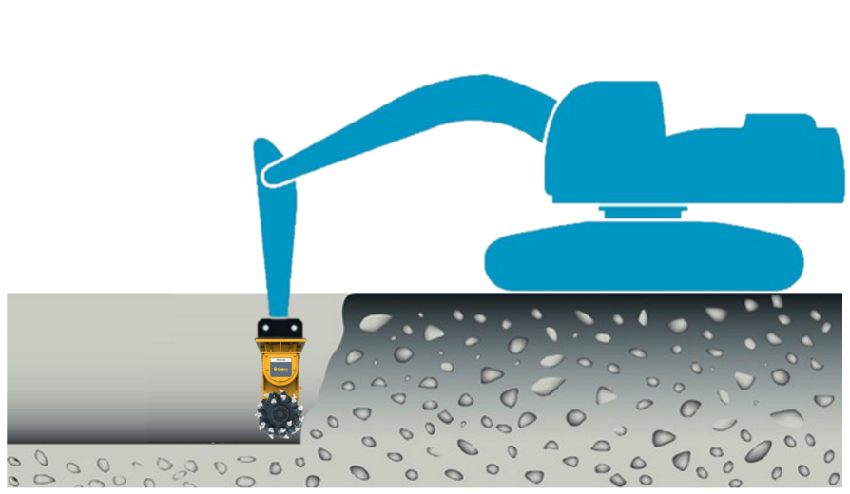
TRANSVERSE DRUM CUTTERS
Optimum cutting head working direction
Vertical surfaces
Horizontal surfaces
Transverse Drum Cutters have to be moved sideways to achieve the required depth and to protect the housing:
 Cutter drum width ≠ Min. Trench width
☑ Cutter drum width + Central strip width = Min. Trench width

Slide 6
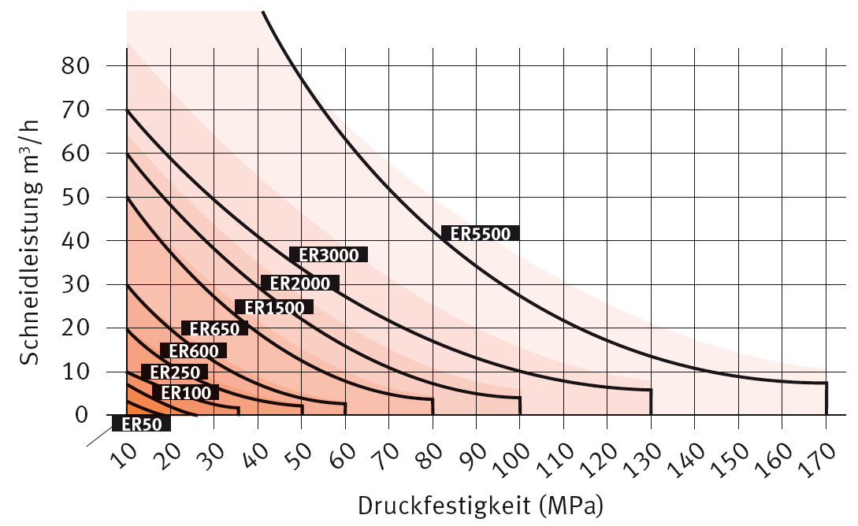
TRANSVERSE DRUM CUTTERS
Productivity
Net cutting rate (m*3/h)
|
Compressive rock strength (MPa)

Slide 7
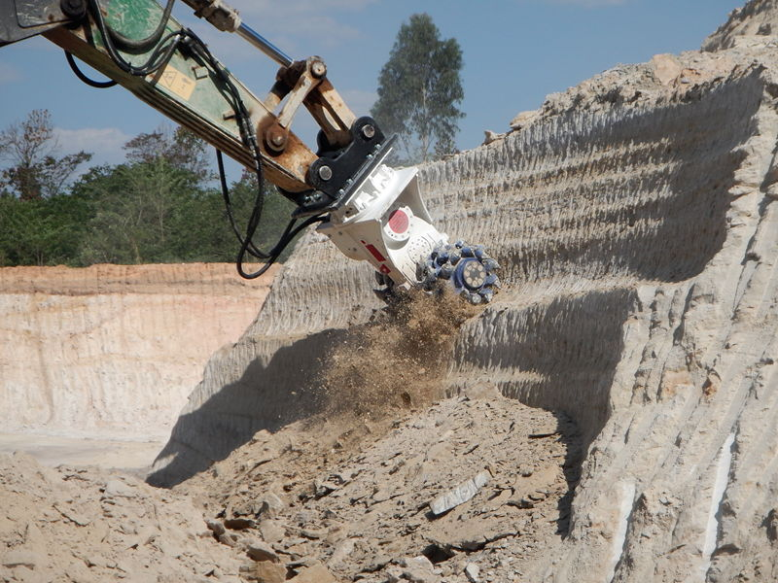
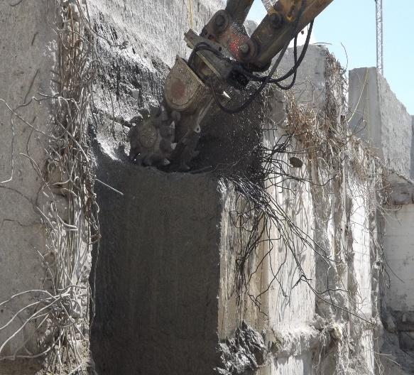
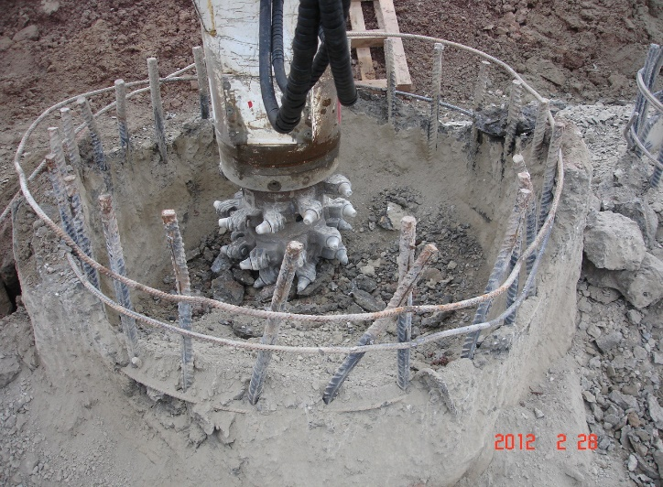
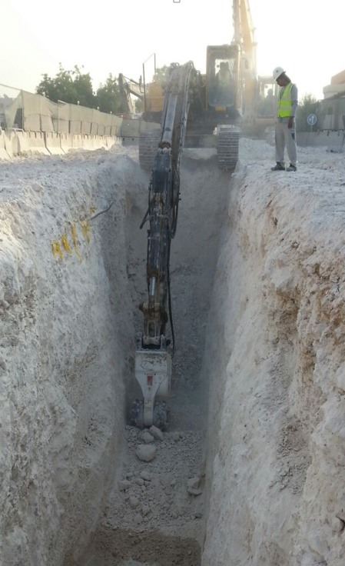
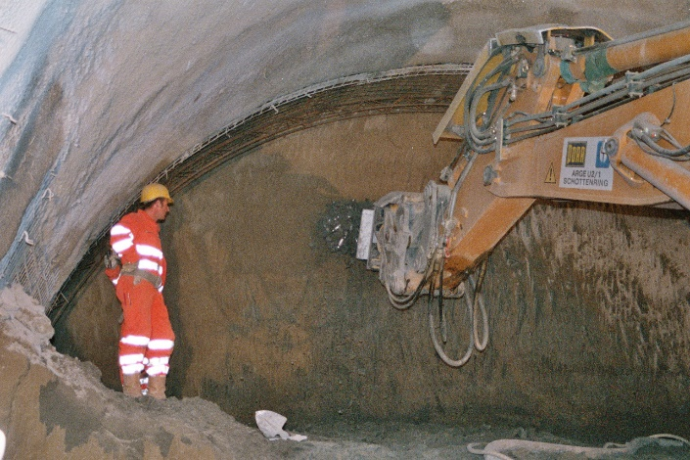
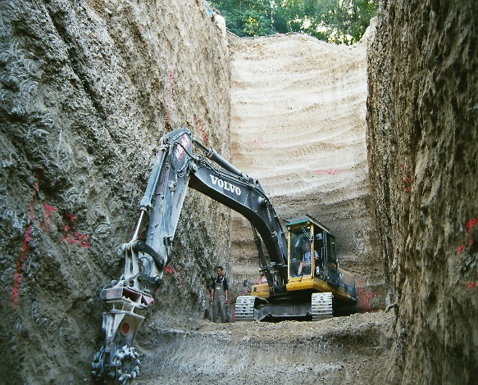
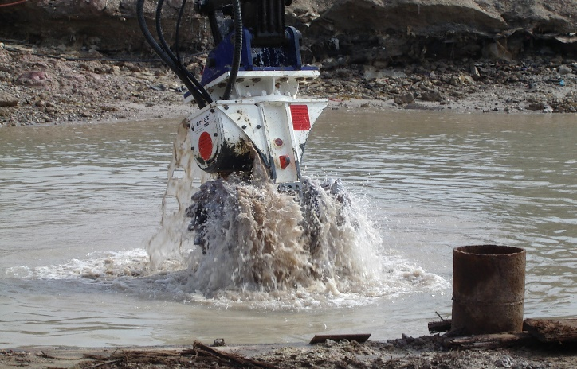
Drum Cutter Main Applications
Mining mass excavation
Demolition / rebuilding
Pilehead cutting
Trenching
Tunneling
Foundations
Underwater

Slide 8
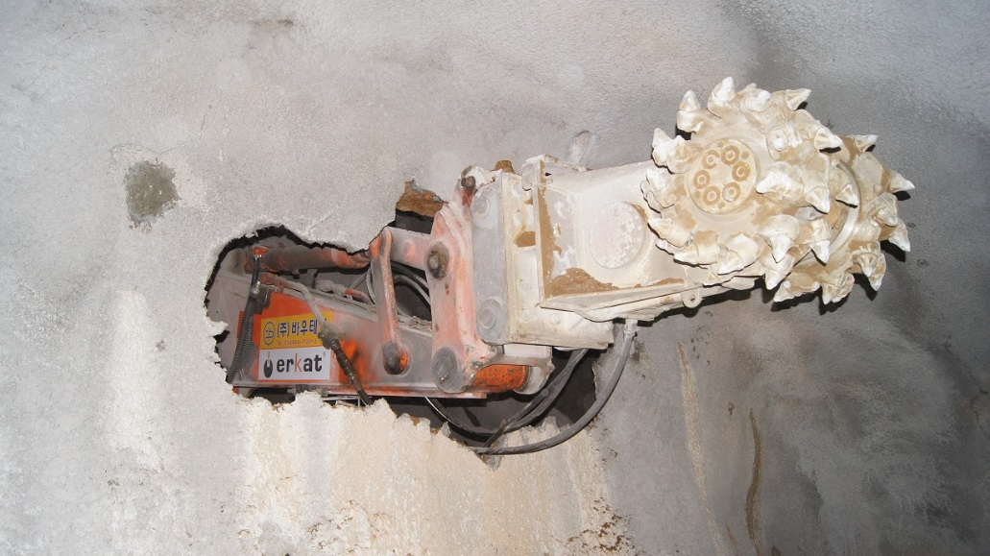
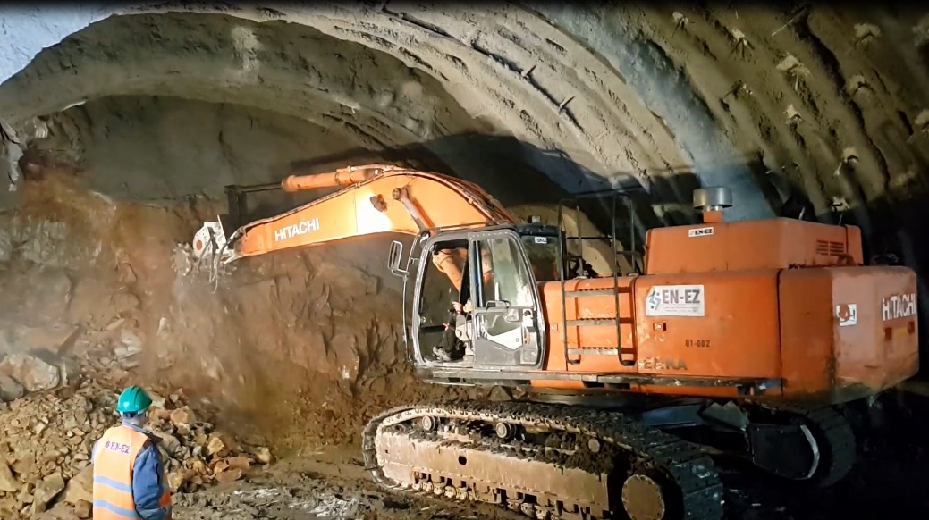
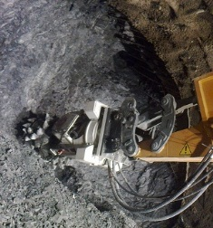
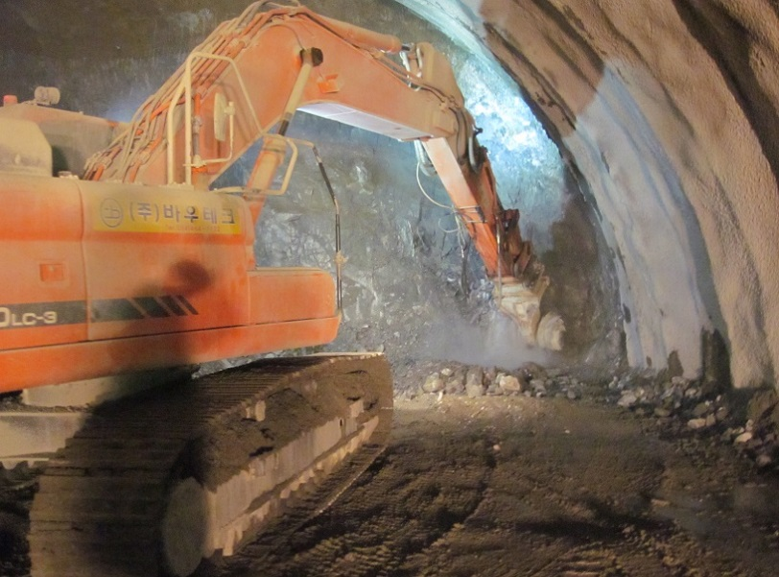
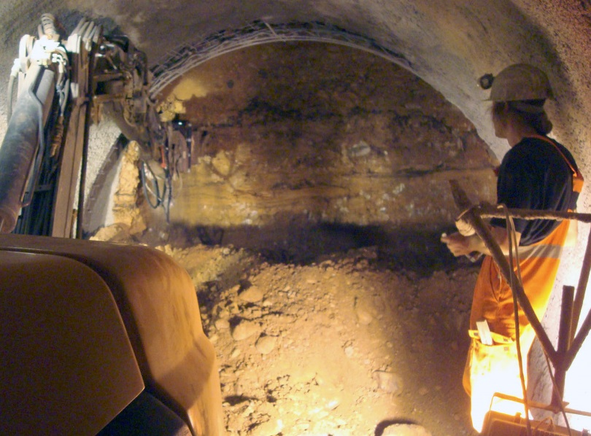
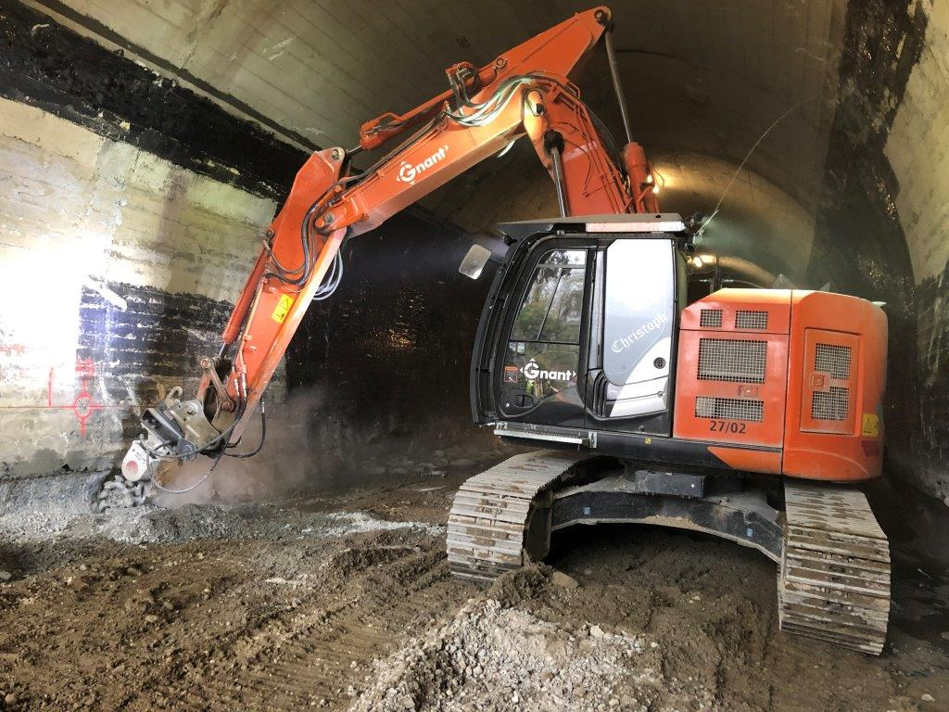
TUNNELING + MINING
TYPICAL APPLICATIONS

Slide 9
Tunneling

